Slide 1

PASSIVE VOICE
Use and form

Slide 2
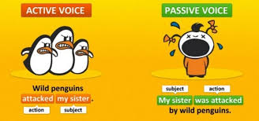

Slide 3
Use of the passive - When and why do we use passive voice?
Although the passive voice is less common than the active voice, there are several good reasons to sometimes use the passive
There are several times when the passive voice is useful, and usually the decision has to do with the "doer" (agent) or the "receiver" of the action. For example, we use the passive when:
1. we want to emphasize the receiver of the action:
President Kennedy was killed by Lee Harvey Oswald.
cf: Lee Harvey Oswald killed President Kennedy.
2. we don't know who did the action (the agent):
My wallet has been stolen.
cf: Somebody has stolen my wallet.
3. we think the agent is not important or interesting:
Our house is being painted.
cf: XYZ Company is painting our house.

Slide 4
Use of the passive - When and why do we use passive voice?
4. the agent is obvious:
I am paid weekly.
cf: My company pays me weekly.
5. we are making general statements or announcements:
Passengers are reminded to fasten their seatbelts.
cf: The Captain reminds passengers to fasten their seatbelts.
6. the agent is everyone:
The emergency services can be called by dialling 999.
cf: The public can call the emergency services by dialling 999.
7. we are writing formal or scientific texts:
Potassium was added and mixed in. The solution was heated to 80°C and then allowed to cool.
cf: The technician added potassium and mixed it in. The technician heated the solution to 80°C and then allowed it to cool.
8. we want to avoid responsibility for our own actions (typically found in government reports):
Mistakes were made and unfortunately never rectified.
cf: The Prime Minister made mistakes and unfortunately never rectified them.

Slide 5
Passive in scientific papers
The passive voice focuses on the object of an action and is used to overshadow the subject of an action
It forces readers to slow down because it places the grammatical subject at the end of the sentences
Ex. This paper discusses the concept of brain mapping in relation to children’s development (active form)
It stresses the subject
It enhanche simplicity and reading speed
Ex. In this paper a discussion of the conceptof childcare is provided
PASSIVE VOICE
Stress the object/action
Refer to backgorund knowledge

Slide 6
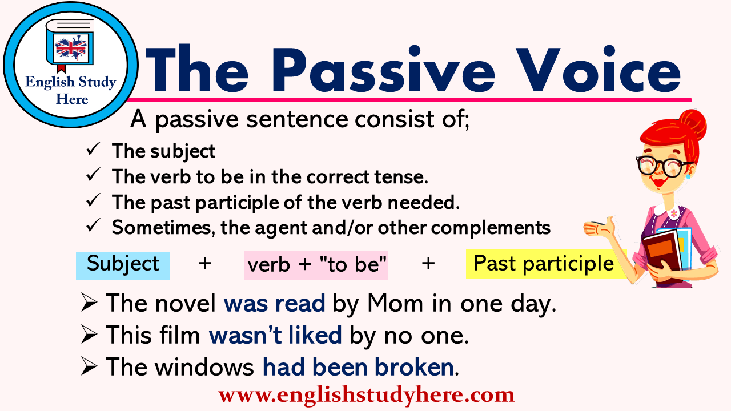
The form of PASSIVE VOICE

Slide 7
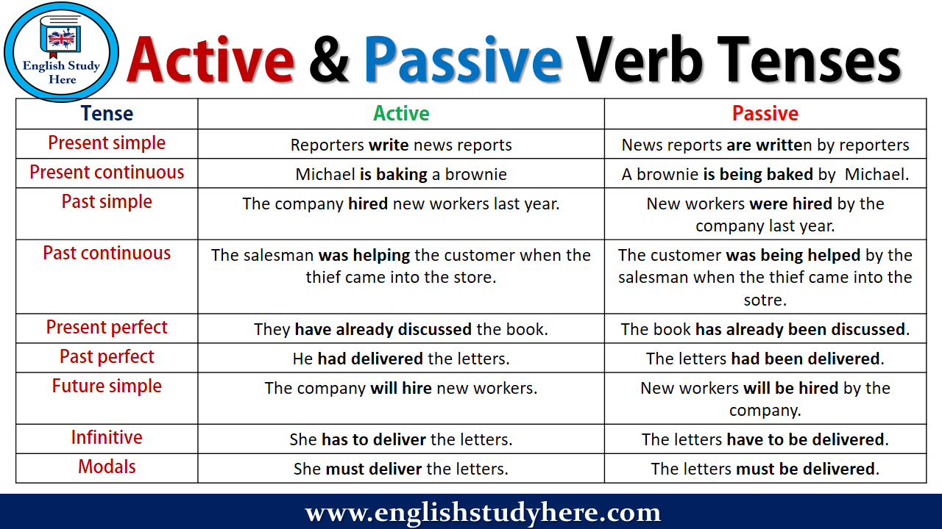
Examples: FROM ACTIVE TO PASSIVE
https://www.ego4u.com/en/cram-up/grammar/passive
https://agendaweb.org/verbs/passive-exercises.html

Slide 8
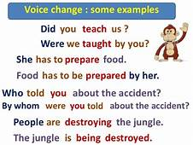
LET’S EXPLAIN PASSIVE VOICE
https://www.perfect-english-grammar.com/passive-exercises.html

Slide 9
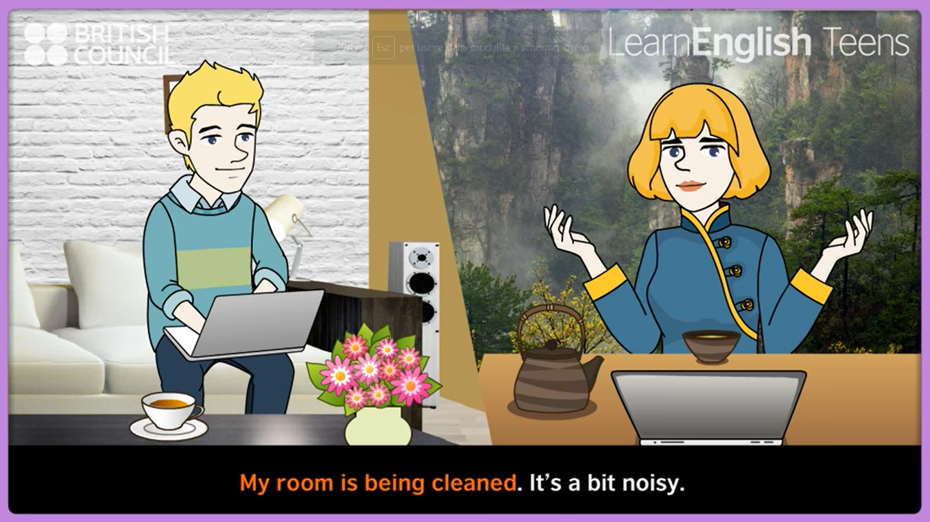
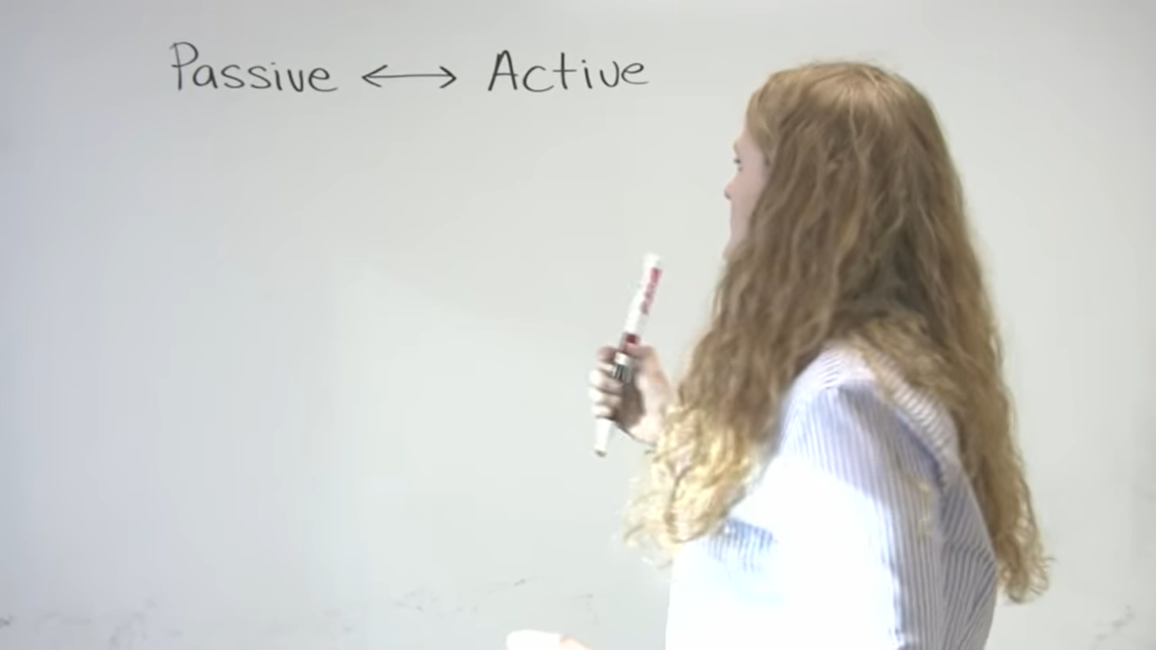
VideoLessons
https://www.youtube.com/watch?v=wxIvJtb_iPk
https://www.engvid.com/easy-introduction-to-passive/

Slide 10

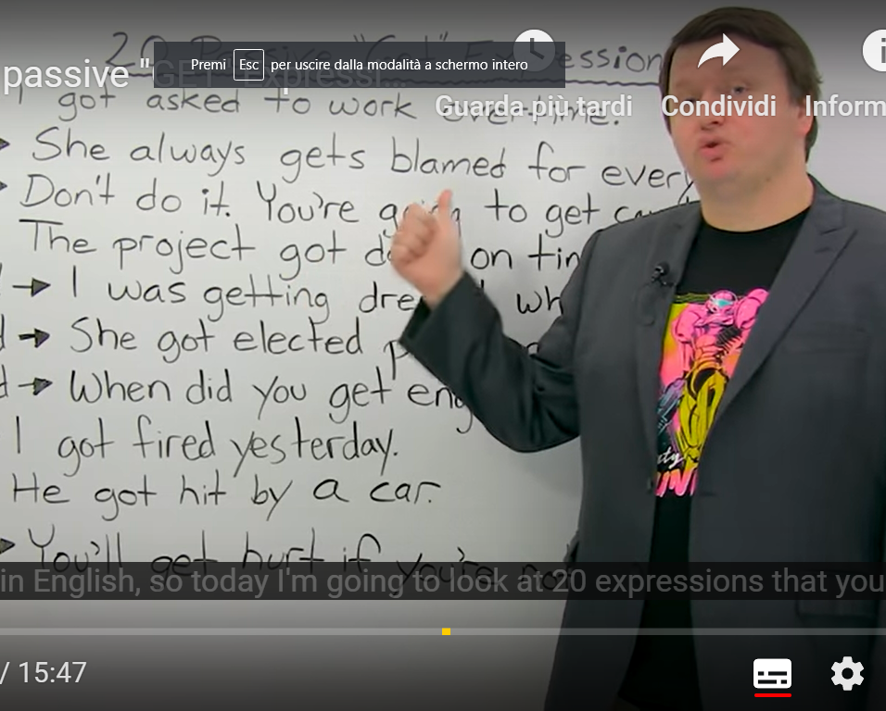
The Get passive
The get-passive
Although we normally construct the passive with be + past participle, it is also possible (in informal language) to use get + past participle. So if France beat England at football, we could turn this to passive and say "England were beaten by France" (be-passive) or "England got beaten by France" (get-passive). And we might also add: "But France will get thrashed by Russia."
For formal English and exams you should use the be-passive, but in informal language people sometimes use the get-passive.
https://www.engvid.com/learn-20-passive-get-expressions-in-english/

Slide 11
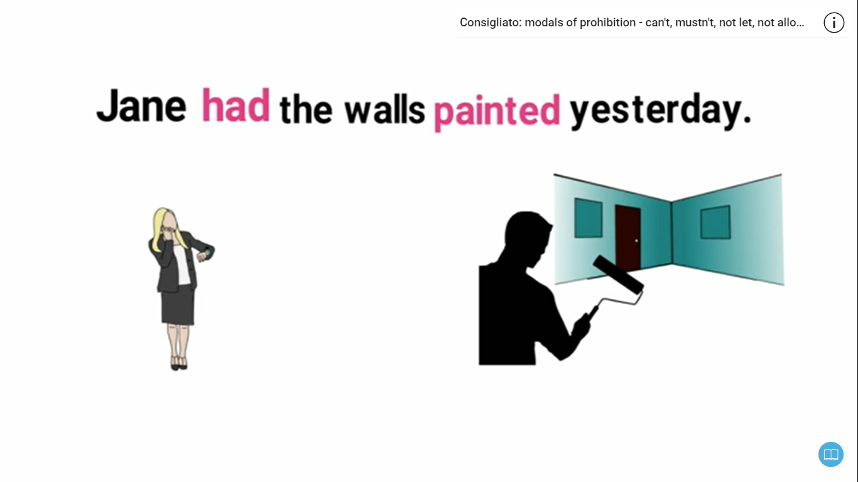
Causative «have» and «get»
Let’s use have and get as passive verbs
https://www.youtube.com/watch?v=bQt2jl2BCrg

