Slide 1

ABSTRACTS
MAIN ASPECTS OF ABSTRACTS

Slide 2
DEFINITION FO ABSTRACTS
All scientific papers start with a reasoned summary, this is an ABSTRACT.
The ABSTRACT is a document with the following main aspects
It is concise
It provides explicitt information on a paper’s topic
It contains keywords of the larger work
It anticipates the theses, the experiments, the lines and sometimes the conclusions too

Slide 3
Types of abstracts
INFORMATIVE
They provide details on the key points of a paper
In case of descriptive papers, they may focus on topics, purposes, claims, lines of reasoning
In case of experimental papers, they will inclusde sections about the topic, methodology, findings and conclusions
They are usually rather long
Their word count ranges from 200 to 500 words
DESCRIPTIVE
They are much shorter
Their word count is usually in the 100 -200 word range
They define the topic of a paper
They do not give specific information on results, methodology and conclusions
They simply state what a paper is about

Slide 4
ABSTRACTS TYPOLOGY
Abstracts can be different according to
1)The editing structure
2)Their adherence to IMRAD format or not
There are three main kinds of abstracts
Structured
Partially structured
Unstructured

Slide 5
Structured abstracts
They are divided into small sections, i.e. background, aim, method, results, conclusions
They present information in a logical, structured way, so they simplify the search for particular items
They are clear and accessible
They are highly informative and contain significant details
They are mostly used to accompany empirical papers

Slide 6
Example #1
Brief Description: This project was partially funded through a subcontract with the National Library of Medicine. As one component of its Health Information for the Public project, HSLS formed a partnership with the WPSD. This partnership allowed for a librarian to provide instruction to health education and learning center teachers and students at WPSD about health resources on the Internet. This paper describes the planning process, curriculum development, and challenges encountered. These challenges include student knowledge of English as a second language, the need for a sign language interpreter, students' third-to-fourth-grade reading levels, and the need for appropriate visual presentations to accompany the audio counterpart.
Purpose: This paper examines the integration of instruction about quality health resources on the Internet into the health curriculum of a specialized high school for students with hearing disabilities.
Setting/Participants/Resources: The Health Sciences Library System (HSLS) at the University of Pittsburgh has formed a partnership with the Western Pennsylvania School for the Deaf (WPSD).
Results/Outcome: The partnership formed between HSLS and WPSD improved deaf high school students' ability to locate quality health information on the Internet.

Slide 7
Example #2
Question: What are the key characteristics of the cohort study design and its varied applications, and how can this research design be utilized in health sciences librarianship?
Data Sources: The health, social, behavioral, biological, library, earth, and management sciences literatures were used as sources.
Study Selection: All fields except for health sciences librarianship were scanned topically for either well-known or diverse applications of the cohort design. The health sciences library literature available to the author principally for the years 1990 to 2000, supplemented by papers or posters presented at annual meetings of the Medical Library Association.
Data Extraction: A narrative review for the health, social, behavioral, biological, earth, and management sciences literatures and a systematic review for health sciences librarianship literature for the years 1990 to 2000, with three exceptions, were conducted. The author conducted principally a manual search of the health sciences librarianship literature for the years 1990 to 2000 as part of this systematic review.
Main Results: The cohort design has been applied to answer a wide array of theoretical or practical research questions in the health, social, behavioral, biological, and management sciences. Health sciences librarianship also offers several major applications of the cohort design.
Conclusion: The cohort design has great potential for answering research questions in the field of health sciences librarianship, particularly evidence-based librarianship (EBL), although that potential has not been fully explored.

Slide 8
Partially structured abstracts
Empirical papers: they give explicit information on the background, aim, method, results and conclusions
Descriptive papers: they give details or topics , purpose, claims, line of reasoning and conclusions
THEY DO NOT CONTAIN SUB - HEADINGS

Slide 9
Example #3
“This study explored the pattern of video game usage and video game addiction among male college students and examined how video game addiction was related to expectations of college engagement, college grade point average (GPA), and on-campus drug and alcohol violations. Participants were 477 male, first year students at a liberal arts college. In the week before the start of classes, participants were given two surveys: one of expected college engagement, and the second of video game usage, including a measure of video game addiction. Results suggested that video game addiction is (a) negatively correlated with expected college engagement, (b) negatively correlated with college GPA, even when controlling for high school GPA, and (c) negatively correlated with drug and alcohol violations that occurred during the first year in college. Results are discussed in terms of implications for male students’ engagement and success in college, and in terms of the construct validity of video game addiction.”

Slide 10
Example #4
“The cell phone is ever-present on college campuses and is frequently used in settings where learning occurs. This study assessed the relationship between cell phone use and actual college grade point average (GPA) after controlling for known predictors. As such, 536 undergraduate students from 82 self-reported majors at a large, public university were sampled. A hierarchical regression (R2 = .449) demonstrated that cell phone use was significantly (p < .001) and negatively (β = −.164) related to actual college GPA after controlling for demographic variables, self-efficacy for self-regulated learning, self-efficacy for academic achievement, and actual high school GPA, which were all significant predictors (p < .05). Thus, after controlling for other established predictors, increased cell phone use was associated with decreased academic performance. Although more research is needed to identify the underlying mechanisms, findings suggest a need to sensitize students and educators about the potential academic risks associated with high-frequency cell phone use.

Slide 11
UNSTRUCTURED ABSTRACTS
They lack intrinsic organization
They provide and describe a general idea of a paper
They give the reader some information about the paper topic and aims
They do not mention results and conclusions
They are rather uniformative overviews
They are not reasoned summaries
They are widely used by literature reviews target articles

Slide 12
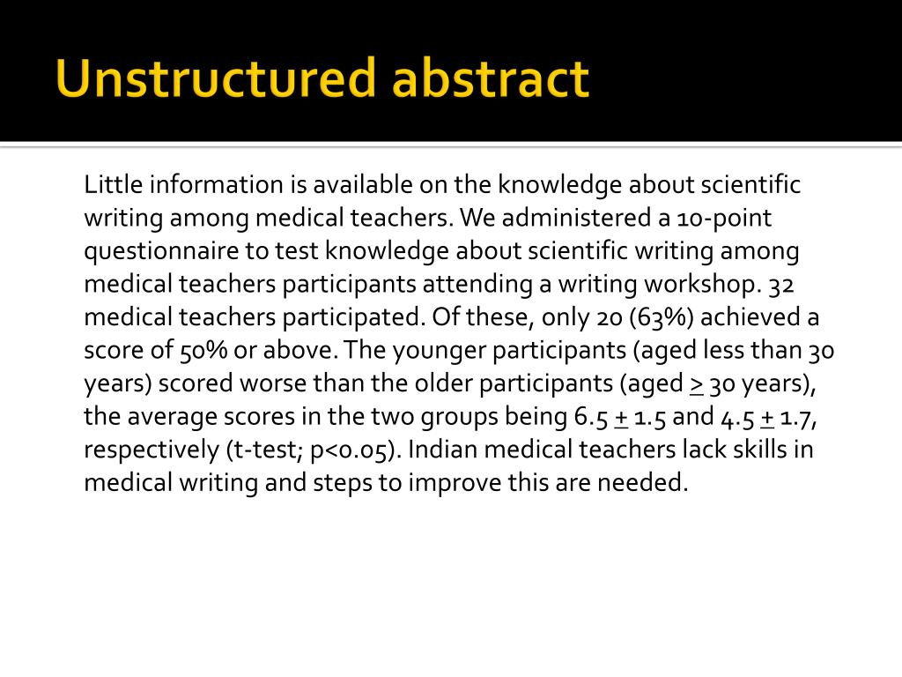
Example #5

Slide 13
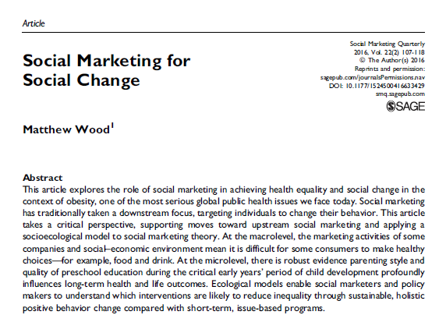
Example #6

Slide 14
Abstracts and paper correlations
Literature review (unstructured)
Theoretical research
Theoretical papers (un or partially str)
Scientific papers
Target articles (un or partially str)
Case Studies (Partially str or un)
Empirical research
Original research papers
Critical trials (str)

Slide 15
Abstracts and scientific speed
They are crucial to the scientific community because they speed up the process of critical reading and simplify literature research..
Scientists’ first step in their long processs of career management is writing papers and discard irrelevant ones.
A scientist has to analyse thousands of volumes, titles, abstracts.
Abstracts are the first part of an article that one reads, tha part that most researchers will ever read.

