Slide 1

IF CLAUSES
From zero to the third conditional

Slide 2
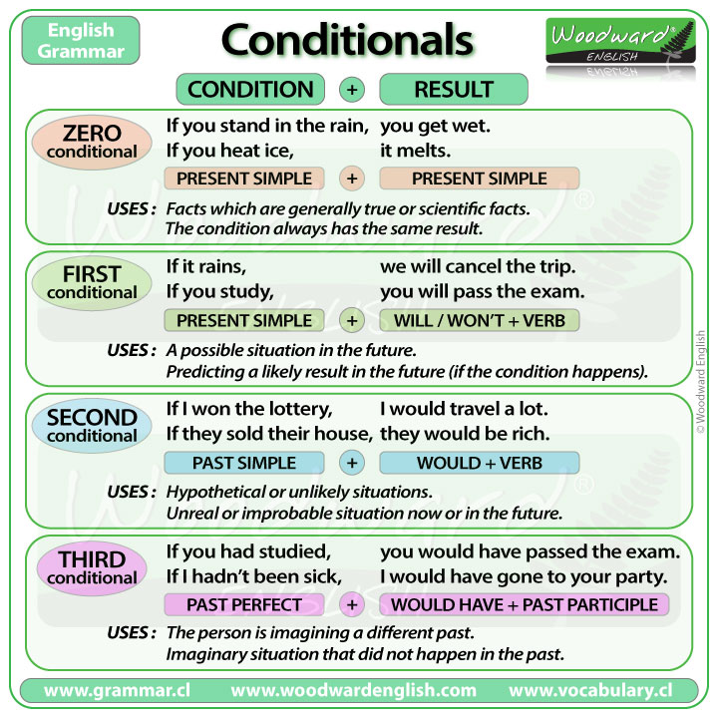

Slide 3
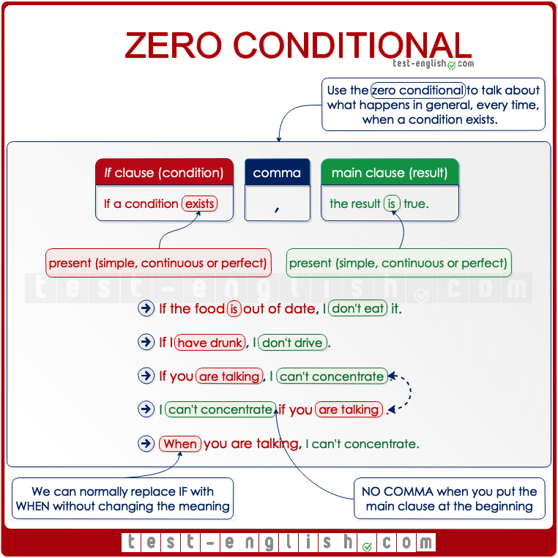

Slide 4
Zero Conditional
The Zero Conditional
We can make a zero conditional sentence with two present simple verbs (one in the 'if clause' and one in the 'main clause'):
If + present simple, .... present simple.
This conditional is used when the result will always happen. So, if water reaches 100 degrees, it always boils. It's a fact. I'm talking in general, not about one particular situation. The result of the 'if clause' is always the main clause.
The 'if' in this conditional can usually be replaced by 'when' without changing the meaning.
For example: If water reaches 100 degrees, it boils. (It is always true, there can't be a different result sometimes). If I eat peanuts, I am sick. (This is true only for me, maybe, not for everyone, but it's still true that I'm sick every time I eat peanuts)

Slide 5
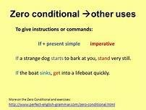
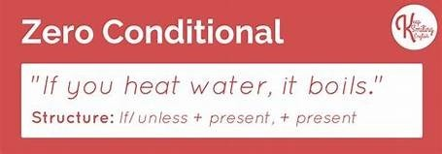
Zero Conditional other uses

Slide 6
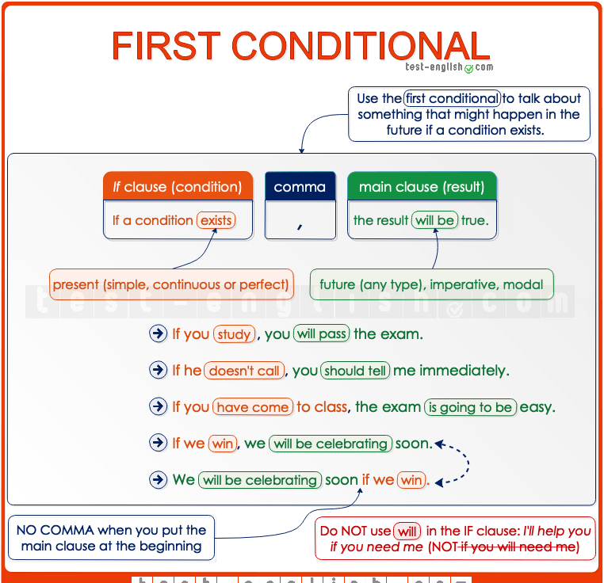
First Conditional

Slide 7
The first conditional: use and form
The first conditional has the present simple after 'if', then the
future simple in the other clause:
if + present simple, ... will + infinitive
It's used to talk about things which might happen in the future. Of course, we can't know what will happen in the future, but this describes possible things, which could easily come true.
If it rains, I won't go to the park.
If I study today, I'll go to the party tonight.
If I have enough money, I'll buy some new shoes.
She'll be late if the train is delayed.
She'll miss the bus if she doesn't leave soon.
If I see her, I'll tell her.

Slide 8
First vs Zero Conditional
The first conditional describes a particular situation, whereas the zero conditional describes what happens in general.
For example (zero conditional): if you sit in the sun, you get burned (here I'm talking about every time a person sits in the sun - the burning is a natural consequence of the sitting)
But (first conditional): if you sit in the sun, you'll get burned (here I'm talking about what will happen today, another day might be different)

Slide 9
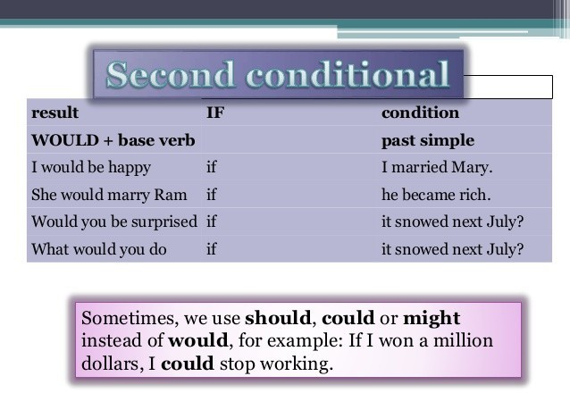
The second conditional

Slide 10
The second conditional
The second conditional uses the past simple after if, then 'would' and the infinitive:
if + past simple, ...would + infinitive
(We can use 'were' instead of 'was' with 'I' and 'he/she/it'. This is mostly done in formal writing).
It has two uses.
First, we can use it to talk about things in the future that are probably not going to be true. Maybe I'm imagining some dream for example.
Second, we can use it to talk about something in the present which is impossible, because it's not true. Is that clear? Have a look at the examples:

Slide 11
EXAMPLES
If I won the lottery,
I would buy a big house. (I probably won't win the lottery)
If I met the Queen of England, I would say hello.
She would travel all over the world if
she were rich.
She would pass the exam if she ever studied.
If I had his number,
I would call him. (I don't have his number now, so it's impossible for me to call him).
If I were you, I wouldn't go out with that man.

Slide 12
WAS - WERE
In the second conditional we can use if I/he/she/it were (more formal) instead of if I/he/she/it was.
If I were/was fit, I would run a marathon.
We wouldn’t have any problems if he were/was more reasonable.
But we use were (NOT was) when we give advice with the expression if I were you.
If I were you, I would stay home and rest.
I wouldn’t pay any attention to what he says if I were you.

Slide 13
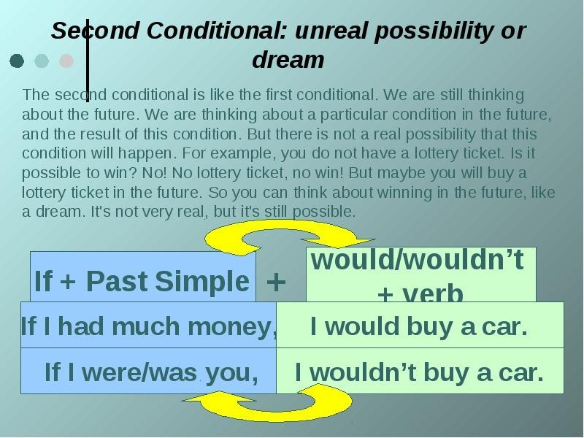
Second Conditional: unreal possibility

Slide 14
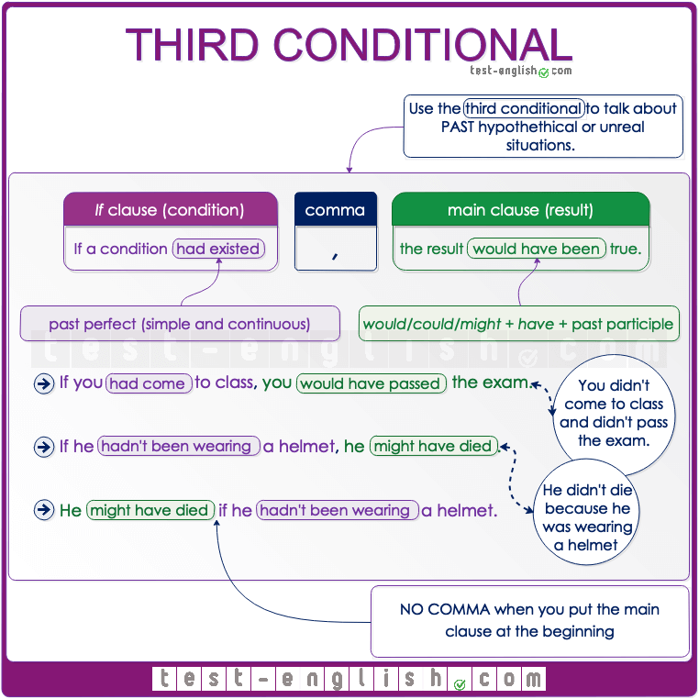
Third conditional

Slide 15
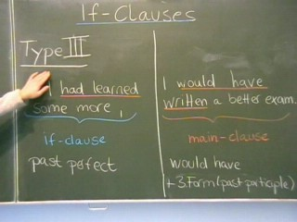
III CONDITIONAL
We make the third conditional by using the
past perfect after 'if' and then 'would have' and the
past participle in the second part of the sentence:
if + past perfect, ...would + have + past participle
It talks about the past. It's used to describe a situation that didn't happen, and to imagine the result of this situation.

Slide 16
USING TYPE 3
If Clauses – Type 3 is used to express the past and the impossible situations that can no longer be changed. In other words, the condition specifed in the clause is imaginary or unreal or impossible condition in the past that did not happen.
Type 3 is often used to express criticism or regret.

Slide 17
If not, unless, in case
We can also use unless in conditional sentences to mean if … (not)
I won’t go on holiday unless I save some money.
= I won’t go on holiday if I don’t save some money.
We use in case to talk about the possibility of something happening. After in case we also use present to talk about the future.
I’ll take my umbrella in case it rains. (=maybe it will rain)
But the meaning of in case is different from if. Compare:
I’ll take my umbrella in case it rains. (=I’ll take my umbrella if it rains and I’ll take my umbrella if it doesn’t rain)
I’ll take my umbrella if it rains. (=I’ll take my umbrella if it rains but I won’t take my umbrella if it doesn’t rain)

Slide 18
ALTERNATIVES TO IF
as long as / provided (that) / providing (that) / on condition (that) / only if
We can use the expressions as long as, provided/providing (that), on condition (that), or only if instead of if when we want to emphasize the condition that needs to be present so that something can happen or be done.
I’ll tell you what really happened as long as you keep the secret.
I’ll lend you the money provided (that) you pay me back next month.
They will speak to the press on condition (that) they remain anonymous sources.
We will invest the money, but only if you can prove that it’s a safe investment.

Slide 19
WHETHER OR NOT/EVEN IF
We use whether or not when there are two alternatives, and we want to say that something will happen or will be true in any of those two alternatives.
I’ll help him if he needs me. (=I will help him only if he needs me.)
I’ll help him whether or not he needs me. (I will help him if he needs me, and I will help him if he doesn’t need me, too.)
We also use even if with a similar meaning to ‘whether or not’. It is used to emphasize that something will still be true or will happen if another thing happens.
Even if you apologise, he’ll never forgive you. (=Whether or not you apologise, he’ll never forgive you.)

Slide 20
DIFFERENT TYPES OF INVERSION
In first conditional sentences it is possible to use should at the beginning of the sentence instead of if. This form is formal and it is quite common with an imperative form in the main clause.
Should you find the answer, please let me know as soon as possible. (=If you find the answer)
Should you change your mind, you know where to contact us. (=If you change your mind)

Slide 21
INVERSIONS: had we arrived - were we to announce
In third conditional sentences, we can invert the auxiliary verb had and leave if out. Had we arrived = If we had arrived.
Had we arrived earlier, we could have prevented the incident.
Had they looked further into the data, they might have realised there was a mistake.
We can also find cases of inversion with this structure: were + subject + to. + infinitive. It is used to talk about future improbable events (like the second conditional).
Were we to announce the truth, we would receive a lot of criticism. (=If we announced …)
Were they to buy a new house, they would need to sell the old one first. (=If they bought …)

Slide 22
Let’s mix them
We use mixed conditionals if we want to mix talking about the present and the past in the same sentence. The mixed conditional is a combination of the second and the third conditional:
We can use past simple or continuous in the if-clause (to refer to the present or future), would/should/might have + past participle in the main clause (to refer to the past).
We can also use past perfect in the if-clause (to refer to the past), and would/should/might + infinitive (to refer to the present).

Slide 23
Mixed conditionals: examples
If I didn’t have (second conditional) so much work, I would have gone (third conditional) to the party last night.
If I spoke (second conditional) German, I would have understood (third conditional) them.
If I had won (third conditional) the lottery, I would be (second conditional) rich.
If I hadn’t dropped (third conditional) school, I could have (second conditional) a better job now.

Slide 24
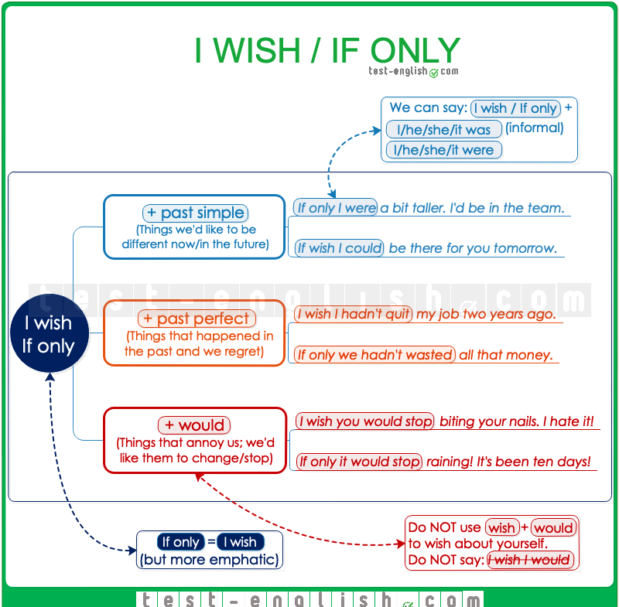

Slide 25

I WISH ….
We can use wish + subject + past simple to talk about things that we would like to be different in
the present or future (but which are very unlikely or not possible).
I wish things were different, but this is the way they are.
We wish we had enough money to help you.
I wish I could be there for you tomorrow.

Slide 26
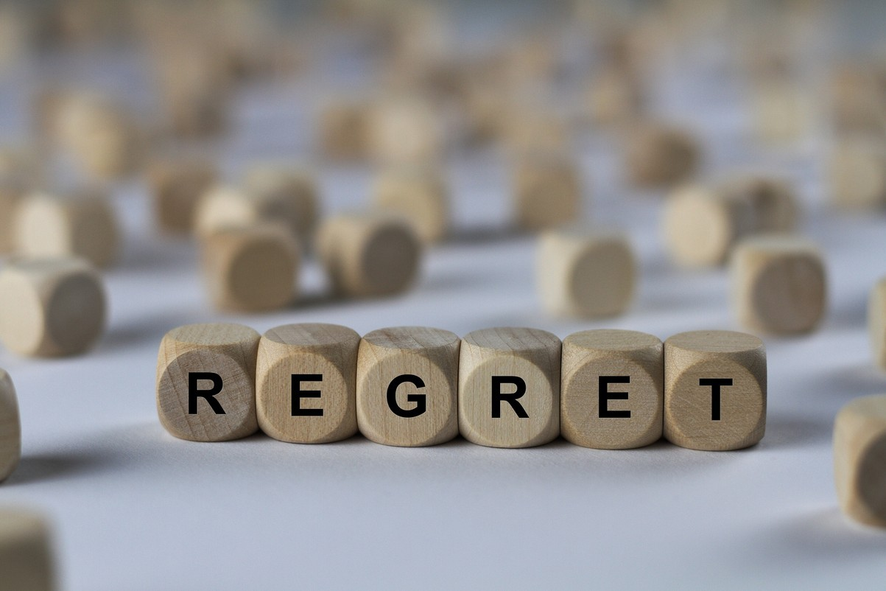
I WISH + PAST PERFECT
We can use wish + subject + past perfect to talk about things that happened in the past and that we regret (we would have wanted them to be different).
I wish I hadn’t quit my job two years ag
I wish we hadn’t wasted all that money

Slide 27

I WISH + WOULD
We can use wish + person/thing + would + infnitive when we talk about situations that annoy us and we would like them to change, or to stop.
I wish you would stop biting your nails. I hate it when you do it.
I wish it would stop raining. It’s been three days!
We CANNOT use this structure to wish about ourselves (do NOT use I wish I would).

Slide 28
IF ONLY
We can use if only instead of I wish with a very similar meaning. The only difference is that if only is more emphatic.
If only I was/were a bit taller!*
If only you had followed my advice.
If only you would make a bit of an effort. You are wasting your life!
Notewe can use were instead of was with I/he/she after I wish/if only.

Slide 29
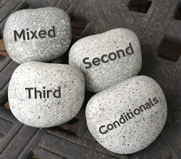
A review of conditionals –video lessons
https://www.youtube.com/watch?v=uDoBdq0s8eY video lesson (about 3 minutes)
https://www.YouTube.com/watch?v=z_L80p8WbLM all the if clauses (about 9 minutes)

