Slide 1

SCIENTIFIC PAPERS
Main aspects

Slide 2
What are the characteristics of scientific papers?
They use technical language, that is words which belong to a particular scientific field
They start with an abstract
They are written following the pattern IBC, i.e. Introduction, Body, Conclusion
They are structured in accordance with the IMRAD format – Introduction, Method, Results and Discussion, i.e. a scientifica layout which sets the standard template for empirical research papers
They are published in specialized journals and reviews

Slide 3
PAPER TIPOLOGY
They can be classified inot two main categories
Research and Descriptive
IBM pattern
True premises are set in the Introduction
A valid argument is found in the Body
True Conclusions are found in the end

Slide 4
DESCRIPTIVE PAPERS
They do not report new scientific facts
They have three different article types
They serv, in turn, three different purposes
LITERATURE REVIEWS
THEORETICAL PAPERS
TARGET ARTICLES

Slide 5
Literature reviews
They describe all past studies and theories on a particular topic to provide updated references – referencing function
They are recommended for graduating students and aprpentice researchers
ONLINE RESOURCE http://binged.it/3kT5cVD

Slide 6
Theoretical papers
They analyse a selection of previous studies and theories to propose some new theoretical constructs – theorizing function
ONLINE RESOURCES http://binged.it/38l2Cma

Slide 7
Target articles
They present a new theoretical challenge, i.e. an original to build or rebuild old scientific problems, to add new contributions to other papers about the same topic and reply in the journal about the same issue – theorizing function
ONLINE RESOURCE http://binged.it/30ktApH

Slide 8
EMPIRICAL PAPERS
Empirical research papers are typically experimental.
They present a hypothesis
They describe one or more experiments
They report the results
They clairfy how and why these experiments were conducted and performed
They are of three different types

Slide 9
ORIGINAL RESEARCH ARTICLES
CLINICAL CASE STUDIES
CLINICAL TRIALS

Slide 10
ORIGINAL RESEARCH PAPERS
They are written by researchers who report in detail what they did and fund. They state
Their hypotheses, methods and findings
Their interpretation of the results

Slide 11
CLINICAL CASE STUDIES
They present real patients’ cases, derived from clinical practice to contribute to shed light on exixting knowledge
They support a hypothesis, based on the assessment and the discussion of risks, psychiatric symptoms, diagnosis, relapse rate
These cases should be supported by a high degree of professional experience

Slide 12
CLINICAL TRIALS
These are reports on controlled perspective studie
Tehy describe their methodology, implementation and findings
They are carried out to test scientifica hypotheses across large samples over time
They are complex, longitudinal and need both experience and clinical skliss

Slide 13
Paper typologies
DESCRIPTIVE
LITERATURE REVIEWS
THEORETICAL PAPERS
SCIENTIFIC PAPERS
TARGET ARTICLES
ORIGINAL RESEARCH PAPERS
EMPIRICAL
CASE STUDIES
CLINICAL TRIALS

Slide 14
Both empirical and descriptive papers
Meta – analyses:
They describe past research
They aim to assess past research
They review a large body of literature
They compare and integrate their findings statistically
They produce a weight average
They classify NEW RESULT
Systematic review
They examine past research but not to provide references
They make use of meta – analyses to provide a summary of the existing research to answer given quesitions
They combine fragments of evidence using sttaistics to reduce bias

Slide 15
IMRAD FORMAT
It is a very commonly used layout to organize empirical content into paper sections
It was introduced in medical science in 1935
I – introduction
M – method
R – results
D - discussion

Slide 16
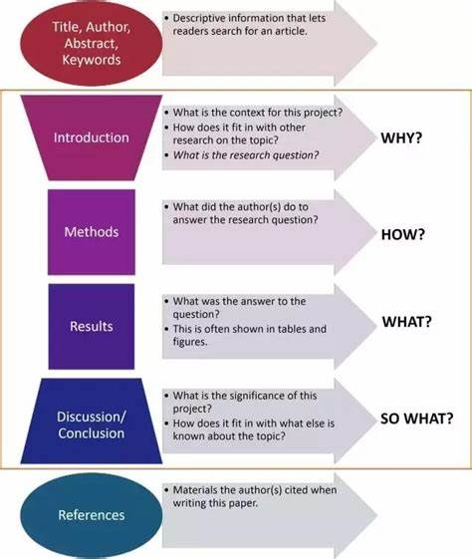

Slide 17
The imrad sections
1) The introduction section
2) The method section
3) The results section
4) The discussion section

Slide 18
THE INTRODUCTION SECTION
This is the area used by the authors to inform readers about their research
They outline the state of art in their research field
They illustrate why they undertook their study
They declare what research question(s) and purpose (s) they have in mind
They declare which hypotheses they formulated

Slide 19
THE METHODS SECTION
In this area the authors
Give details about their experimental procedures and setups
They inform the readrs about when, how and where their study(ies) was/were conducted
They inform the readers about the materials they used, how many participants were sampled, what procedures were used, which measurement scales

Slide 20
THE RESULTS SECTION
In this section the authors
Report their findings as much objectively they can
Provide percentages, rates and scores
They often integrate this sections with tables, graphs, figures

Slide 21
THE DISCUSSION SECTION
This section focuses on
Experimental results and tested hypotheses to explore what they may imply for the specific research field
Why they matter to the scientific community
Which direction they indicate for future investigations

Slide 22
ADVANTAGES OF IMRAD PATTERN
It improves clarity
It demands the author(s) to order the information into sections
It increases reading speed
It provides, under specific headings all significant information
It helps readers to rapidly search through the sections
It allows readers to skip unecessary steps and leads you directly to the appropriate section the reader needs

Slide 23
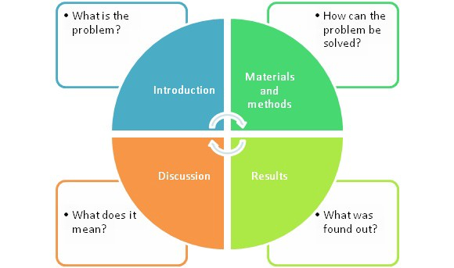

Slide 24
From imrad to active to active reading
What active reading is
Scanning
Skimming
Abstract

Slide 25
RESOURCES
http://binged.it/3epBZjD VIDEO LESSON ABOUT IMRAD FORMAT (about 7 minutes)
http://binged.it/3qCZLLr VIDEO LESSON ABOUT IMRAD FORMAT (about 4 minutes)

Slide 26


