Slide 1





IUSTO
ENGLISH CLASS
Cabassi Matteo

Slide 2





Welcome to our final lesson!

Slide 3
First of all: congratulations on you completing the course (almost...)

Slide 4

Main points from our last lesson
  Teen hot issues
  What’s a hot issue
  Eating disorders
  Gender identity
  Bullying and cyberbullying
  Learning disorders and disabilities

Slide 5
Objectives:
  To learn about specific topics for educators and teachers: adolescence and important issues;
  To enlarge and enrich vocabulary on a specific area of technical English: adolescence, gender identity, eating disorders, relationships, pedagogical questions;
  To improve speaking and debating skills;
  To practice reading, listening and oral comprehension on given topics and work on them orally and in writing;
  To improve reading for the gist and to exercise reading for further meaning;
  To relate a topic to broader cultural and social issues/problems.
Today’s class: objectives and topics

Slide 6
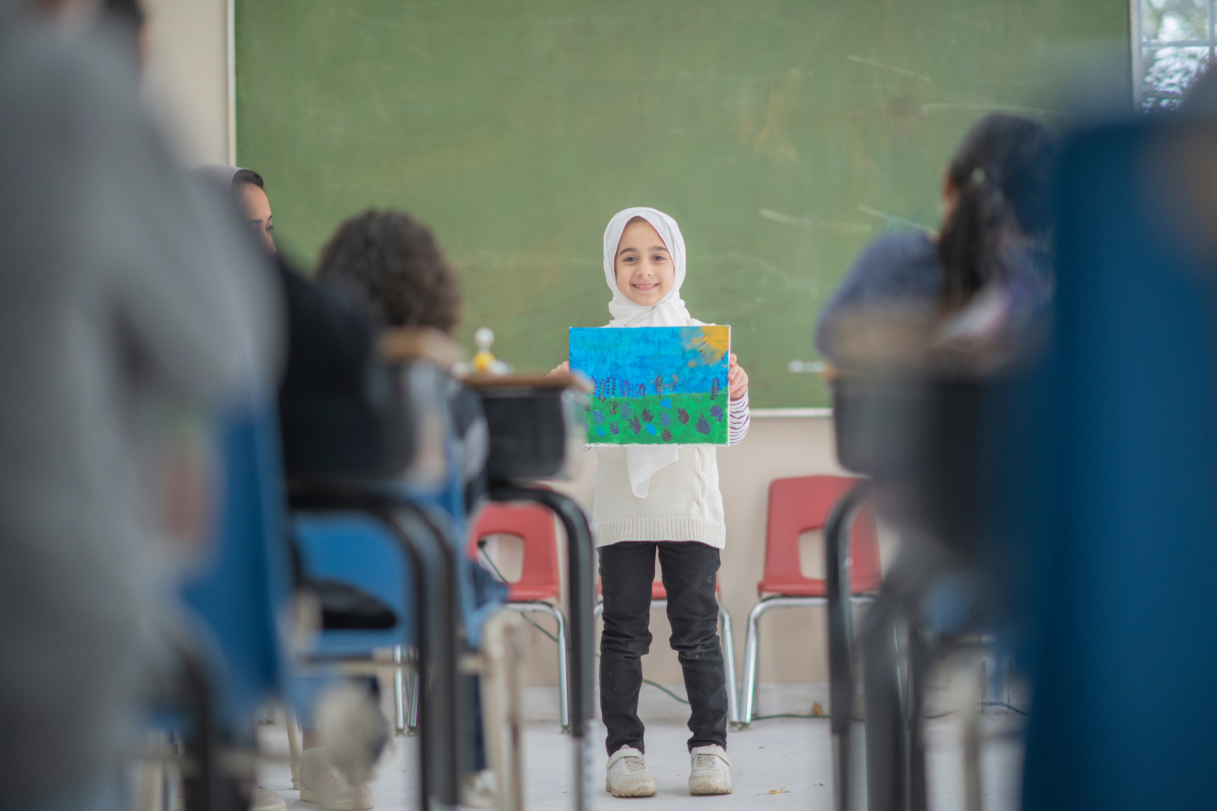
Assignment: check
  Watch the two videos on dyslexia and disabilities;
  As you watch the two videos, write a summary for each (of about 200-250 words);
  Think about one or two possible solutions to spread awareness among teachers, educators (and consequently: teenagers and children) about these issues;
  Write your answers ON THE PADLET, following the INSTRUCTIONS and EXAMPLES.

Slide 7
TED Talk
This video is about dyslexia and learning disorders. As you listen, produce a short summary (200-250 words) and think about the following question (and write the answer!):
How can we spread more awareness on this topic among teachers, teenagers, children, parents?
Dyslexia - TED Talk

Slide 8
TED Talk
  This video is about disabilities and how to create an inclusive culture. As you watch the video, create a short summary of it (200-250 wors).
  As you watch it, think about and answer the following question: how can we spread inclusivity in schools and in the work environment about disabilities?
Disability: an inclusive future - TED Talk

Slide 9
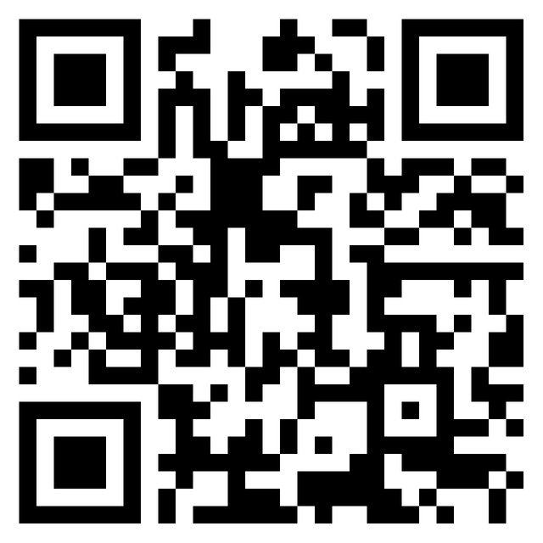
PADLET
HOMEWORK: Padlet
  Write your answers on this PADLET;
  Follow the examples provided by the Professor to post your comments;
  IF YOU WANT, you are more than welcome to comment on other students’ posts.

Slide 10
MATERIALS
  Pages 11, 12, 47, 48.
  Let’s read some of the texts and do some of the exercises.

Slide 11
NOW: THE WRITTEN EXAM
You have 2 hours.

Slide 12
THANK YOU
See you at the exam!
Enjoy your holidays!

