Slide 1





IUSTO
ENGLISH CLASS
Cabassi Matteo

Slide 2





Previously, on the English class...

Slide 3

Main points from our last lesson
  Stages of human development: childhood, adolescence, adulthood;
  Presentations;
  Discussion of the results, ideas and improvements;
  Adolescence and the poem Hanging Fire by Audre Lorde.

Slide 4
Teen hot issues: Topics and themes concerning teenagers
Today’s class: objectives and topics

Slide 5
Objectives:
  To learn about specific topics for educators and teachers: adolescence and important issues;
  To enlarge and enrich vocabulary on a specific area of technical English: adolescence, gender identity, eating disorders, relationships, pedagogical questions;
  To improve speaking and debating skills;
  To practice reading, listening and oral comprehension on given topics and work on them orally and in writing;
  To improve reading for the gist and to exercise reading for further meaning;
  To relate a topic to broader cultural and social issues/problems.
Today’s class: objectives and topics

Slide 6
“Teen hot issues”: what’s a “hot issue”?

Slide 7
A hot issue is a vastly debated topic, often concerning and worrying, especially for a given social category/group (i.e. teenagers).
Our role as educators
As educators, pedagogists, teachers, professors... What is our role? What can we do?
Discuss together for 5 minutes and provide examples.

Slide 8
What are the hot issues?
  Eating disorders
  Gender identity and sexual orientation
  Bullying
  Cyberbullying
  Anything else...?

Slide 9
  Are you familiar with the main eating disorders?
  What could their causes be?
  What’s the role of friends, the school and (especially) teachers/educators?
  Do fashion, the media and social media culture have a role in it? Why/why not?
  Do you believe this topic is still a taboo? Why?
Eating disorders

Slide 10
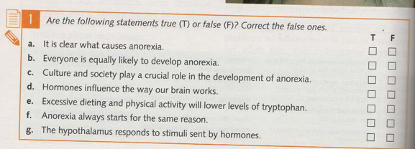
Eating disorders

Slide 11
  What do we mean with the term gender identity? And sexual identity?
  What are the differences between gender identity and sexual orientation?
  Is it an issue that only affects teenagers? Why/why not?
  In your opinion, why is it still a problem for today’s culture and society?
  What’s the role of adults (teachers, parents, etc.)?
Gender identity

Slide 12
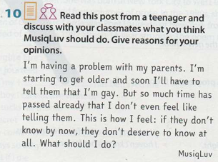
Gender identity

Slide 13
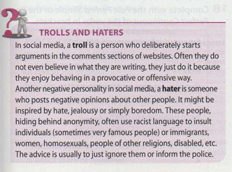
  How can we define bullying?
  What are the most common forms of bullying?
  In your opinion, why is bullying so difficult to stop?
  How could teachers/educators/professors prevent it?
  What are the roots of bullying and the violence it creates?
  Who are trolls and haters?
Bullying and cyberbullying

Slide 14
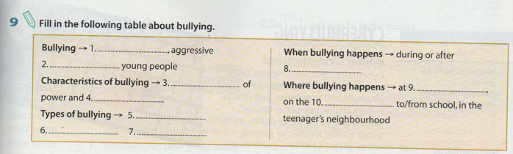
Bullying and cyberbullying

Slide 15
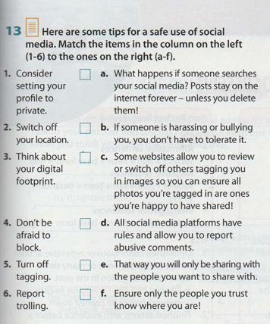
Bullying and cyberbullying

Slide 16
This is starting to become a hot issue, too…
  What is a learning disorder?
  What’s the difference between disorder and disability?
  Does it affect only teenagers?
  Are they still considered a “problem” today?
  What is a “disability”?
  How are disabilities included (or not) in schools?
  What’s the role of educators/teachers?
Learning disorders and disabilities

Slide 17
TED Talk
This video is about dyslexia and learning disorders. As you listen, produce a short summary (200-250 words) and think about the following question (and write the answer!):
How can we spread more awareness on this topic among teachers, teenagers, children, parents?
Dyslexia - TED Talk

Slide 18
TED Talk
  This video is about disabilities and how to create an inclusive culture. As you watch the video, create a short summary of it (200-250 wors).
  As you watch it, think about and answer the following question: how can we spread inclusivity in schools and in the work environment about disabilities?
Disability: an inclusive future - TED Talk

Slide 19
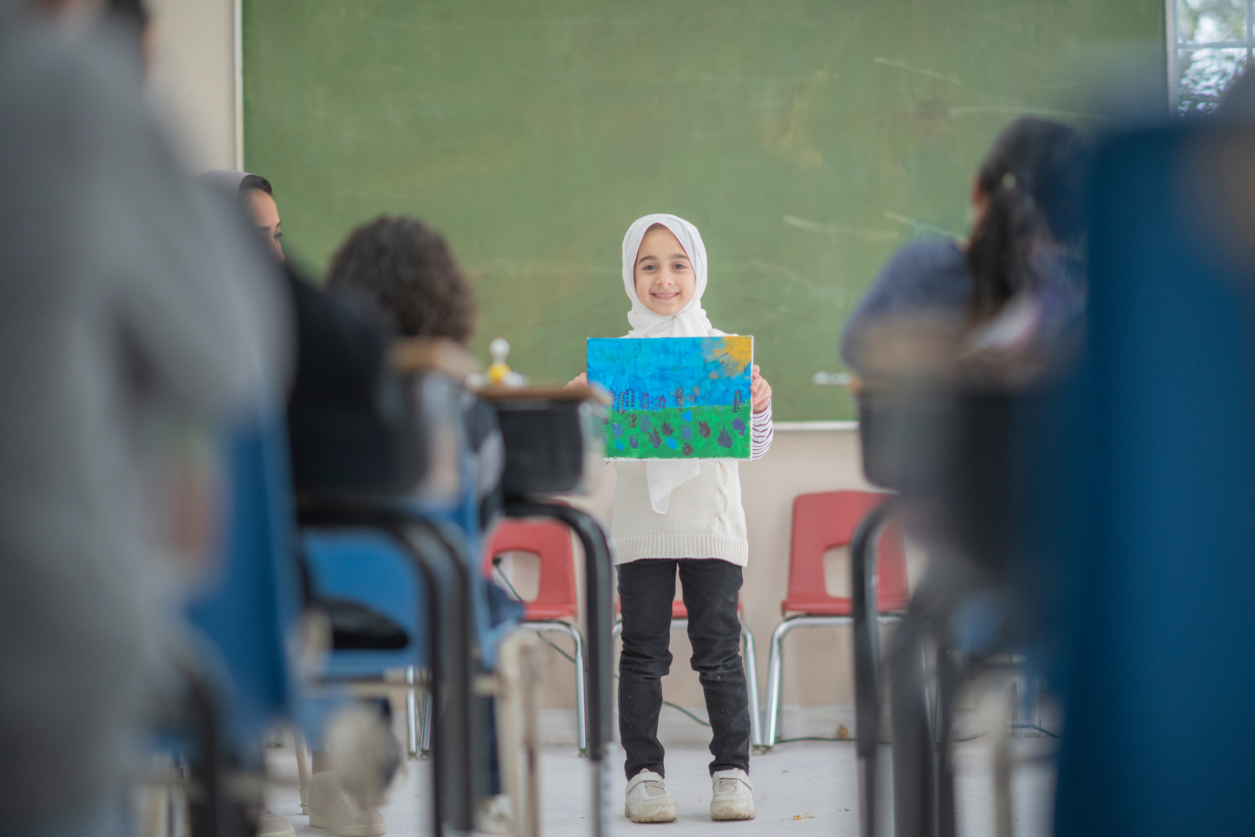
Assignment
  Prepare for the end-of-term (written) exam! And good luck!

Slide 20

PADLET
HOMEWORK: Padlet
  Write your answers on this PADLET;
  Follow the examples provided by the Professor to post your comments;
  IF YOU WANT, you are more than welcome to comment on other students’ posts.

Slide 21
THANK YOU
See you next time!

