Slide 1





IUSTO
ENGLISH CLASS
Cabassi Matteo

Slide 2





Previously, on the English class...

Slide 3

  Stages of human development
  Human developmental milestones
  Main theories and main authors
  Podcast
  J. Piaget
  S. Freud
  E. Erikson
  C. Gilligan
Main points from our last lesson

Slide 4
human development, PRESENTATIONS, ADOLESCENCE
Today’s class: objectives and topics

Slide 5
Objectives:
  To learn about specific topics for educators and teachers: life stages and milestones;
  To enlarge and enrich vocabulary on a specific area of technical English: life stages and milestones;
  To improve speaking and debating skills;
  To learn how to re-elaborate a text and enhance one’s own language skills orally;
  To face scientific information and topics and summarize, reorganize and acquire them;
  To present scientific topics to an audience and to practice answering/asking questions on a scientific topic.
Today’s class: objectives and topics

Slide 6

A SHORT AND BRIEF REVISION

Slide 7
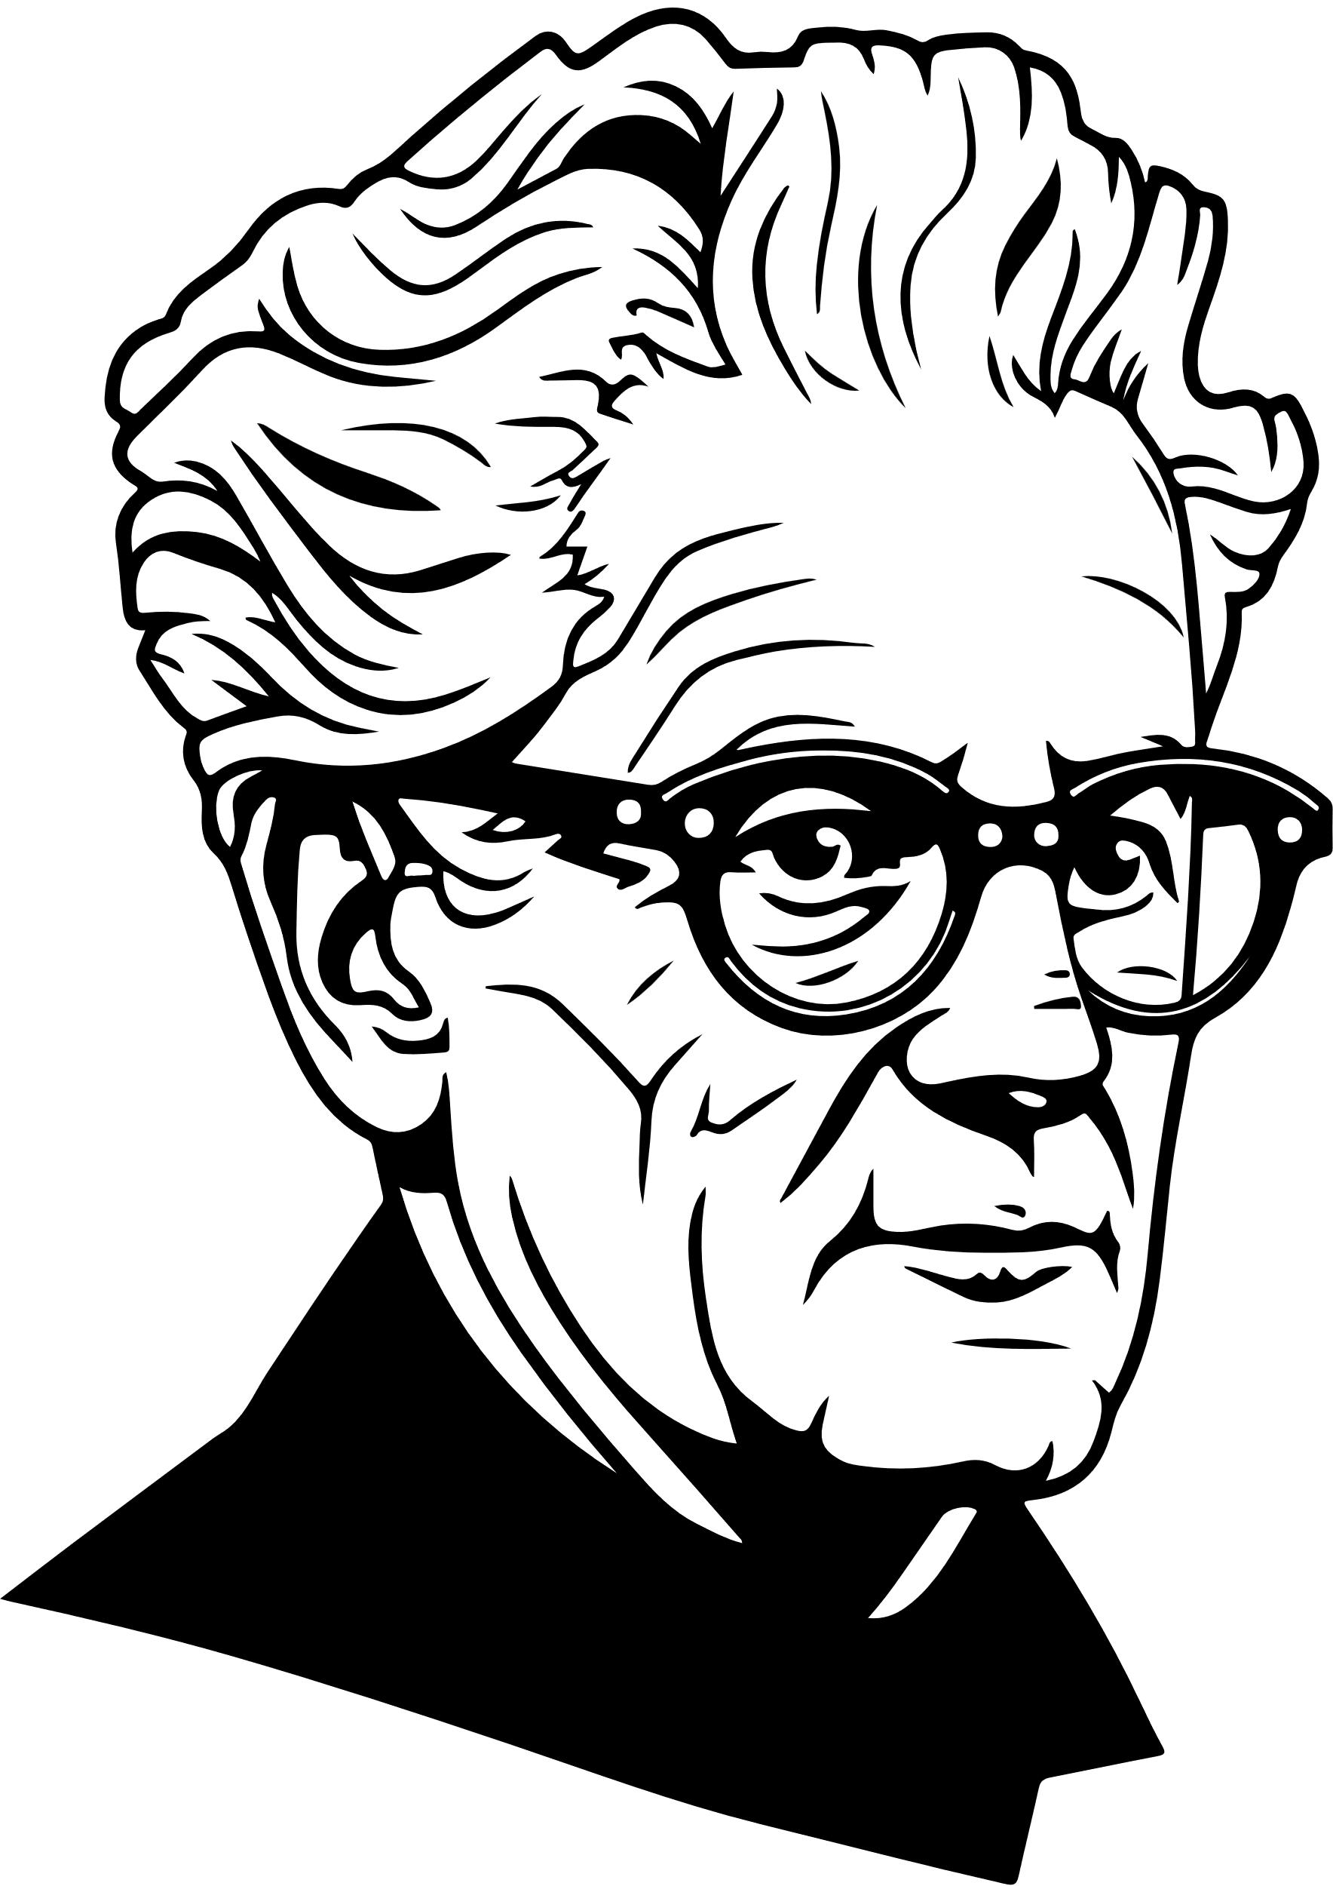
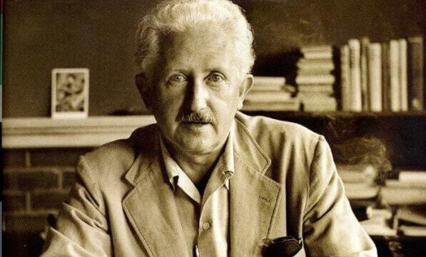
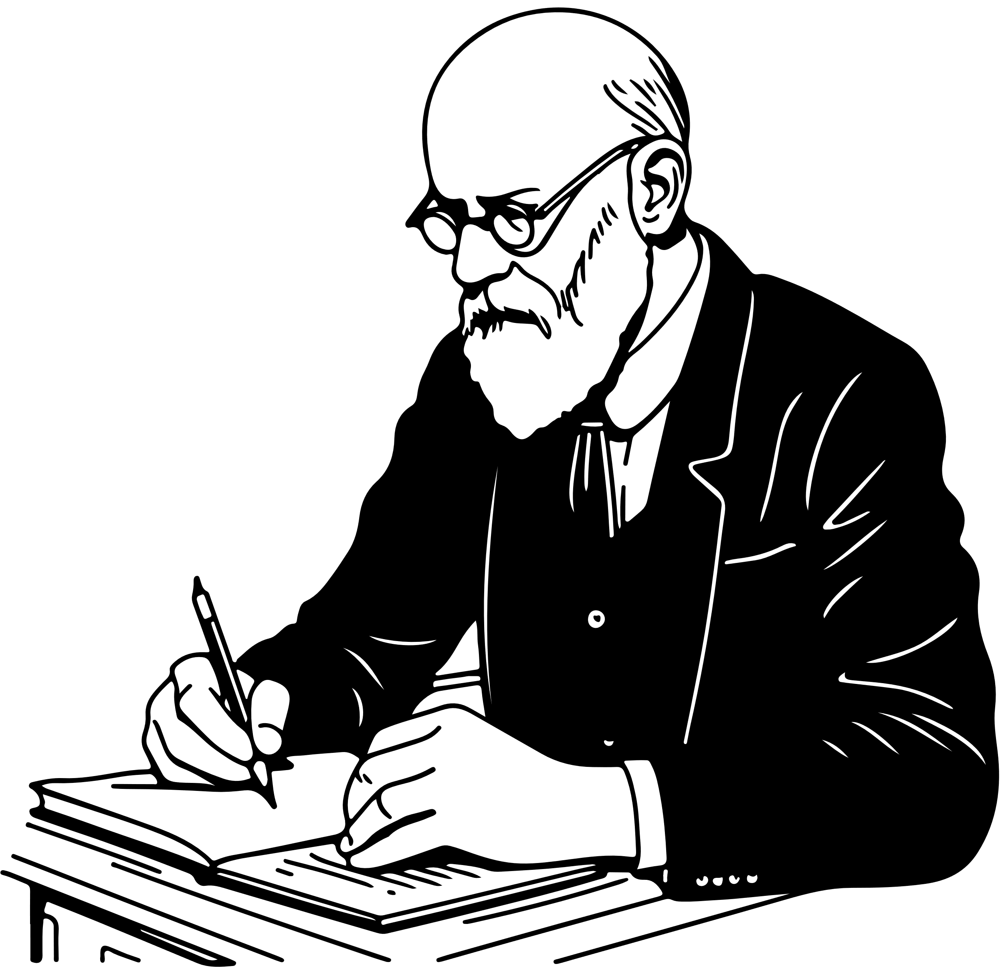
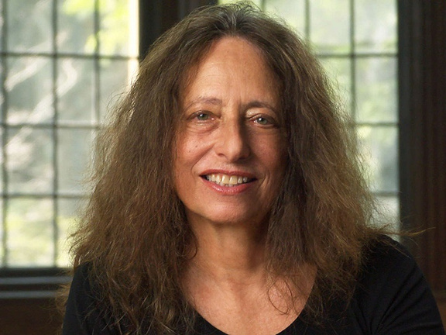
Our “beloved” scholars
  J. Piaget’s theory: cognitive
  S. Freud: psychosexual
  E. Erikson: social
  C. Gilligan: moral

Slide 8

  How do human beings grow up?
  What are humans able to do at different ages?
  What are the specific characteristics of each milestone in human development?
  What are the main theories in developmental psychology?
  How does developmental psychology inform our practice as educators and teachers?
Questions we want to answer in our presentations

Slide 9
  The presentation must have a maximum of 5 slides (title included) and must contain:
  general information on the life stage (1);
  a short focus on one or two developmental psychologists that worked on this particular life stage (2);
  a life situation (a dilemma, a particular event, a problem, an issue) that might happen and how you’d solve it as an educator (3);
  a comprehension exercise for the rest of the class (4).
Presentations: content and tasks

Slide 10
LET’S BEGIN!
Good luck everybody!

Slide 11
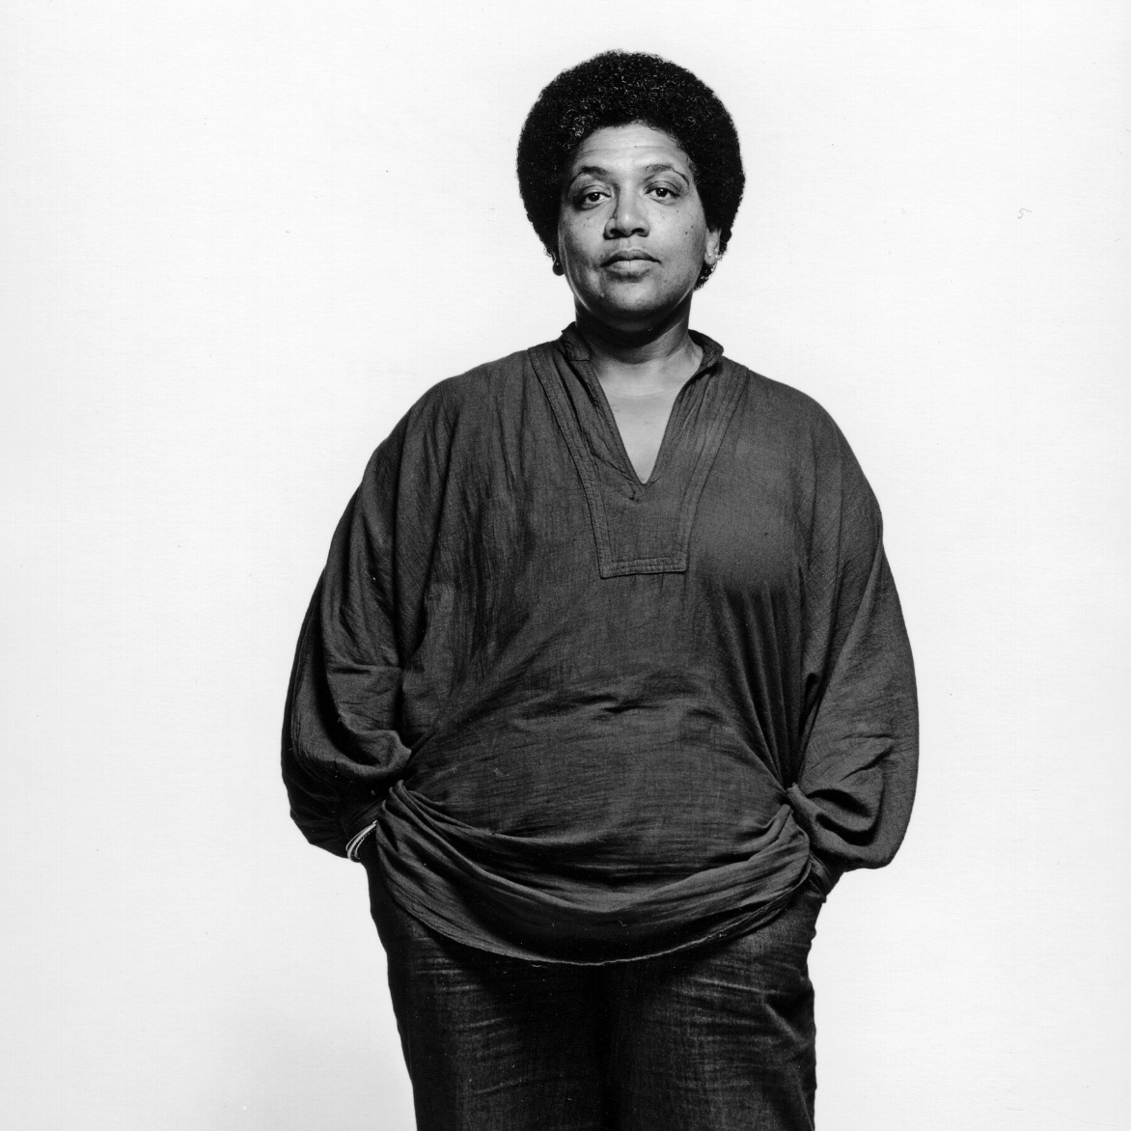
A Poem About Adolescence
Audre Lorde
Audre Lorde (1934-1992) was a multi-talented writer, educator and activist. She described herself as a «black, lesbian, mother, warrior, poet». She was born in New York City to West Indian parents. In addition to numerous volumes of poetry, Lorde published four volumes of prose. In the 1980s, she and writer Barbara Smith founded Kitchen Table: Women of Color Press. Lorde was Poet Laureate of New York from 1991-1992.
She died of cancer in 1992 after a 14-year struggle. The poem that follows was published in «The Black Unicorn» (1978).

Slide 12
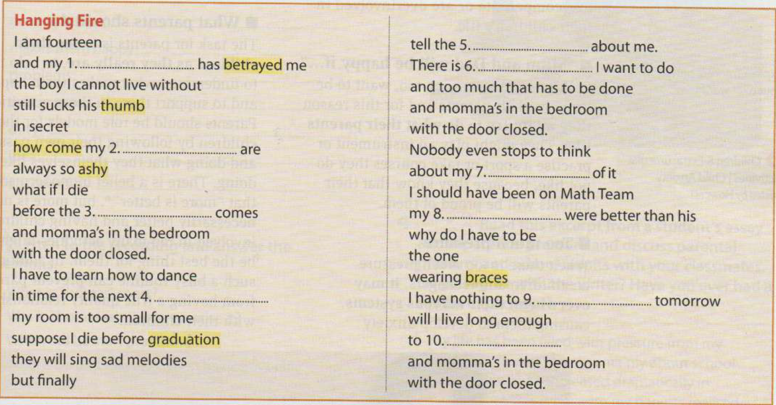
Hanging Fire
Audre Lorde

Slide 13
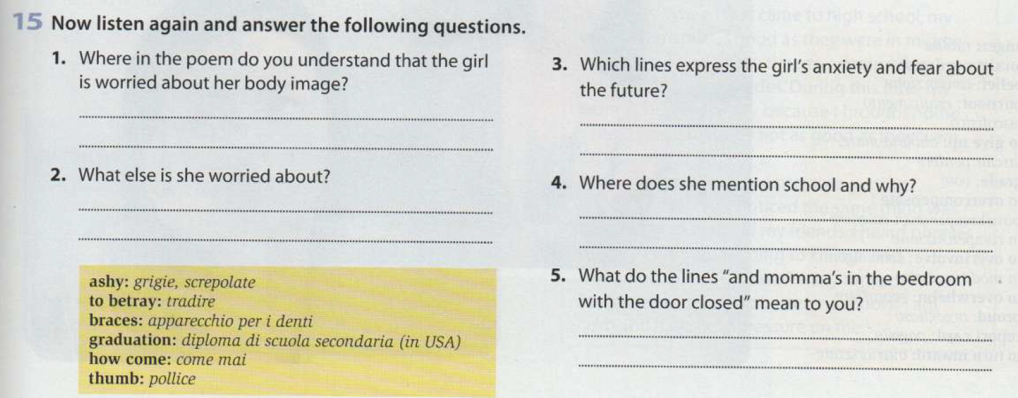
Hanging Fire
Audre Lorde

Slide 14
Trauma
What’s trauma?
The age of trauma and Trauma Studies.
What are some of the effects of trauma on our lives?
How can we guide people (especially young people) as educators/teachers through trauma and healing?

Slide 15
LISTENING ACTIVITY
We are going to do a listening activity, connected to human development, the role of trauma and how our lives develop from traumatic childhoods.
TED Talk - Childhood trauma

Slide 16
LISTENING ACTIVITY
  What experiences are categorized as “adverse childhood experiences”?
  What correlation did they find between an ACE score and health outcomes?
  How does exposure to early adversity affect developing brains and bodies of children?
  If a person with a high ACE score doesn’t engage in high-risk behavior, why are they still more likely to heart disease or cancer?
TED Talk - Childhood trauma

Slide 17
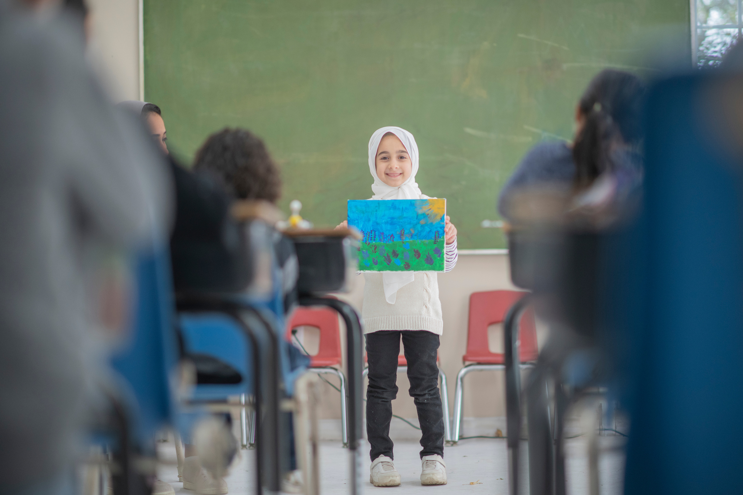
Assignment
  Open the Materials;
  We are going to work on “teen hot issues”
  Read the following materials: pages 16-17-18-19-31-34-36;
  you are expected to come to class prepared: we are going to work on the texts, issues and topics in our next lesson.

Slide 18
THANK YOU
See you next time!

