Slide 1





IUSTO
ENGLISH CLASS
Cabassi Matteo

Slide 2





Previously, on the English class...

Slide 3

  Discussions, self-reflection and group speaking;
  Human development: the role of the brain;
  Human development: life stages;
  Human development: brain development and the theory of bimodality.
Main points from our last lesson

Slide 4

life stages and milestones
Today’s class: objectives and topics

Slide 5
Objectives:
  To learn about specific topics for educators and teachers: life stages and milestones;
  To enlarge and enrich vocabulary on a specific area of technical English: life stages and milestones;
  To improve reading and comprehension skills;
  To learn how to re-elaborate a text and enhance one’s own language skills;
  To face scientific information and topics and summarize, reorganize and acquire them.
Today’s class: objectives and topics

Slide 6
A SHORT AND BRIEF REVISION

Slide 7
The role of the mind
  Biological psychology: what is it and what does it study;
  The brain: hemispheres and functions;
  The areas of the brain involved in the learning process;
  Lateralization and brain dominance;
  The theory of bimodality.

Slide 8
Stages of human development
  How do human beings grow up?
  What are humans able to do at different ages?
  What are the specific characteristics of each milestone in human development?
  What are the main theories in developmental psychology?

Slide 9
  In groups, share your findings from your homework research and compile a list of psychologists and their ideas.
  Present them to the rest of the class, but in a very specific way: you need to create a short podcast! You have 1 minute to present your findings, as if you were informing a crowd through a short radio program. Make it interesting!
SPEAKING – Science pills

Slide 10
Here’s a collection of famous developmental psychologists and scholars who worked on human development: we’re going to read about Piaget, Erikson, Freud and Gilligan.
Life stages - theories

Slide 11
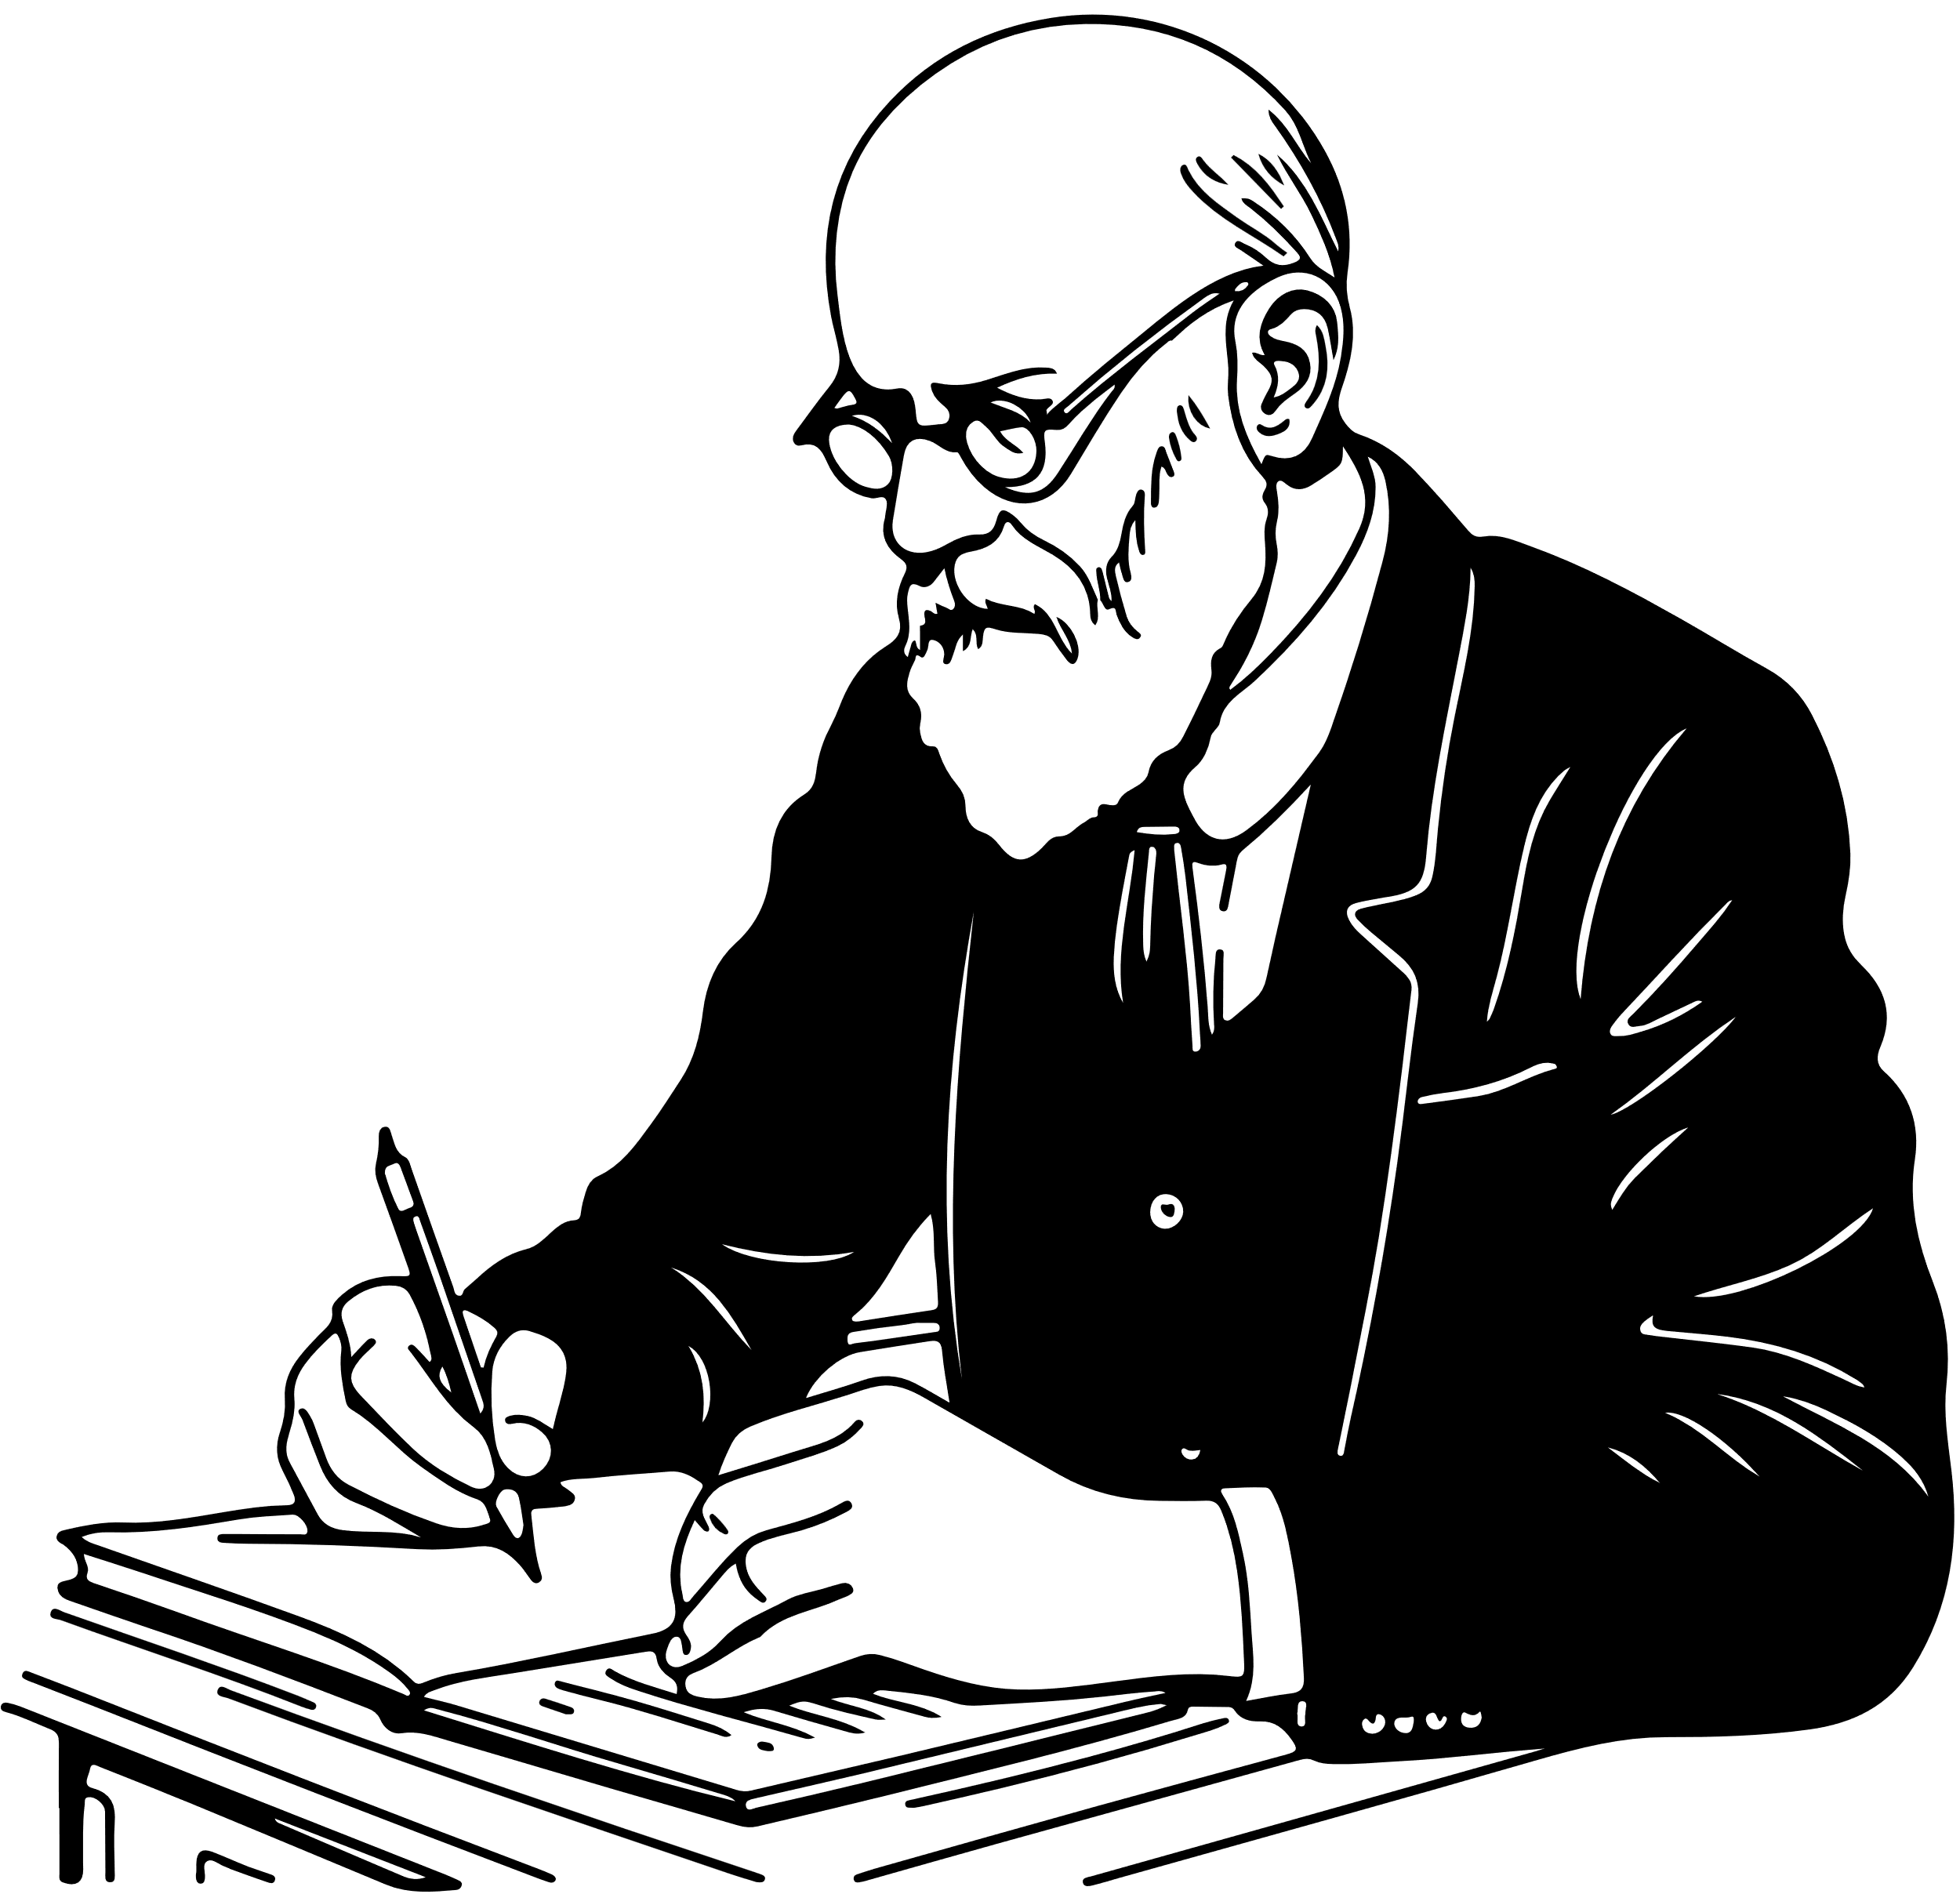

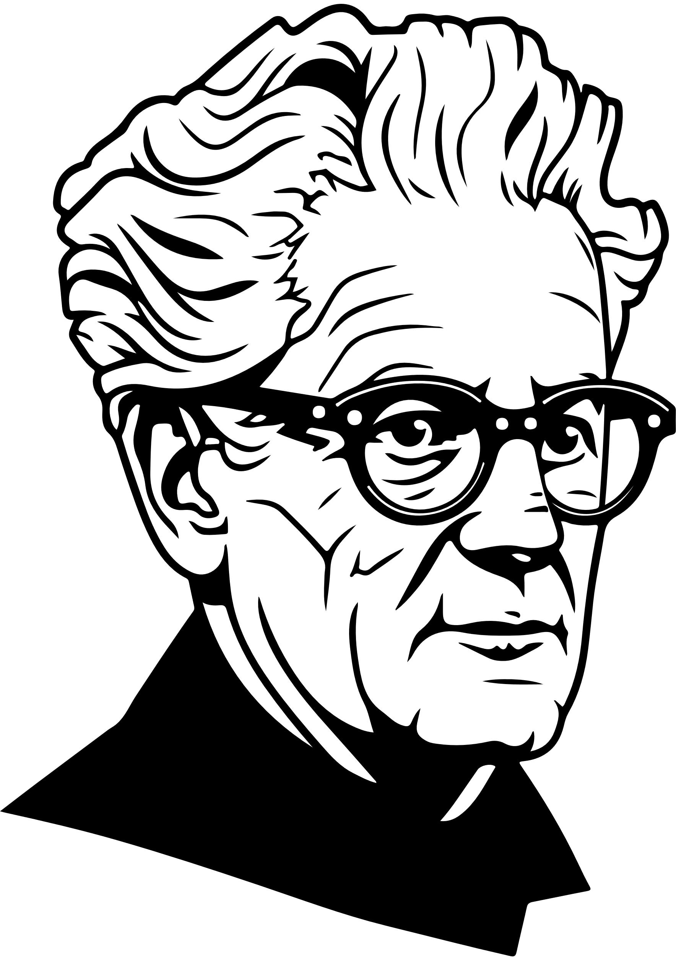
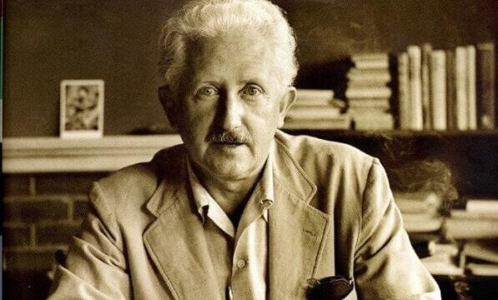

Slide 12
Jean Piaget’s Theory of Cognitive Development
Jean Piaget, a Swiss psychologist, believed that children learn and think differently than adults. His theory explains how thinking and understanding grow over time. Piaget said that children go through four stages of cognitive development as they grow.
  Sensorimotor Stage (0–2 years):
  Babies learn through their senses (like touching and seeing) and actions (like grabbing and moving). At this stage, they do not understand that objects still exist even if they cannot see them. For example, if you hide a toy, the baby thinks it is gone forever.
  Preoperational Stage (2–7 years):
  At this stage, children start using language to express themselves. They can think about things but still see the world only from their own perspective. For example, a child might think everyone likes the same food they do.
  Concrete Operational Stage (7–11 years):
  Here, children begin to think logically about concrete (real) things. They can solve problems, but only if they are about things they can see or touch. For example, they understand that if you pour water from a short glass into a tall glass, the amount of water stays the same.
  Formal Operational Stage (12 years and older):
  In this stage, teenagers and adults can think abstractly. They can imagine different possibilities and think about the future. For example, they can understand concepts like freedom or justice.
Piaget’s theory helps teachers and parents understand how children think at different ages. This way, they can teach and support them better.

Slide 13
Sigmund Freud’s Psychosexual Theory of Development
Sigmund Freud, an Austrian neurologist, believed that early childhood experiences shape a person’s personality. According to Freud, humans have unconscious desires and instincts that influence their behavior. He explained his ideas through five psychosexual stages:
  Oral Stage (0–1 year):
  Babies get pleasure from their mouths by sucking, biting, or chewing. If this need is not met, they might develop habits like nail-biting or overeating as adults.
  Anal Stage (1–3 years):
  During this stage, children learn to control their bladder and bowel movements. If this process is too strict or too lenient, it can affect their personality. For example, strict potty training might lead to someone being very organized as an adult.
  Phallic Stage (3–6 years):
  At this stage, children start noticing differences between boys and girls. Freud said children also develop feelings for the parent of the opposite sex, like a boy for his mother. These feelings are eventually resolved.
  Latency Stage (6–12 years):
  In this stage, children focus on learning and friendships. Sexual feelings are less important.
  Genital Stage (12 years and older):
  This stage starts during adolescence. People begin to develop romantic relationships and focus on their future.
Freud’s ideas are controversial, but they highlight the importance of early childhood experiences in shaping who we are.

Slide 14
Erik Erikson’s Psychosocial Development Theory
Erik Erikson, a German-American psychologist, focused on how people grow emotionally and socially throughout their lives. He described eight stages of development, and each stage has a key challenge that shapes a person’s identity.
  Trust vs. Mistrust (0–1 year):
Babies learn to trust their caregivers if their needs are met. If not, they may feel insecure about the world.
2. Autonomy vs. Shame (1–3 years):
Toddlers learn independence by doing things themselves, like eating or dressing. If criticized, they may feel doubt about their abilities.
3. Initiative vs. Guilt (3–6 years):
Young children start exploring and taking initiative. If they are discouraged, they may feel guilty about trying new things.
4. Industry vs. Inferiority (6–12 years):
School-age children learn skills and feel proud of their achievements. If they fail or are compared to others, they may feel inferior.
5. Identity vs. Role Confusion (12–18 years):
Teens explore who they are and what they want to do in life. If they are unsure, they may feel confused about their identity.
6. Intimacy vs. Isolation (18–40 years):
Young adults form close relationships. If they struggle, they may feel lonely.
7. Generativity vs. Stagnation (40–65 years):
Middle-aged adults focus on helping others, like raising children or working. If not, they may feel unproductive.
8. Integrity vs. Despair (65+ years):
Older adults reflect on their lives. If they feel satisfied, they develop wisdom. If not, they may feel regret.
Erikson’s theory shows that development is a lifelong process.

Slide 15
Carol Gilligan’s Theory of Moral Development
Carol Gilligan is an American psychologist who studied how people make moral decisions. She was a student of Lawrence Kohlberg, who created a theory of moral development. Kohlberg’s theory focused on how people think about right and wrong, but Gilligan noticed something missing. Most of Kohlberg’s research was done with boys and men, so his stages did not fully explain how girls and women make moral choices. Gilligan believed that women often think differently about moral problems.
Gilligan said that men and women approach morality in two different ways. Men usually focus on rules, justice, and fairness. For example, they might think it is important to follow a law, even if it seems unfair to some people. On the other hand, women often focus on care and relationships. They might ask, “How will this decision affect the people involved?” instead of only following rules.
Gilligan explained her ideas using three levels of moral development:
  Preconventional Stage:
  At this stage, people think about what is best for themselves. For example, a child might say, “If I share my toy, I won’t get in trouble.”
  Conventional Stage:
  Here, people think about what others expect and try to please them. For example, a teenager might say, “I have to help my friend because they helped me before.”
  Postconventional Stage:
  At this level, people think about the needs of everyone and try to balance fairness and care. For example, an adult might decide to speak up for someone being treated unfairly, even if it is risky for them.
Gilligan’s theory is important because it reminds us that morality is not just about following rules. It is also about thinking of others and building strong relationships. Her work helped people understand the importance of care and empathy in moral decisions.

Slide 16
Trauma
What’s trauma?
The age of trauma and Trauma Studies.
What are some of the effects of trauma on our lives?
How can we guide people (especially young people) as educators/teachers through trauma and healing?

Slide 17
LISTENING - TED Talk
  What experiences are categorized as “adverse childhood experiences”?
  What correlation did they find between an ACE score and health outcomes?
  How does exposure to early adversity affect developing brains and bodies of children?
  If a person with a high ACE score doesn’t engage in high-risk behavior, why are they still more likely to heart disease or cancer?
TED Talk - Childhood trauma

Slide 18

  Divide into groups, again. Work on a presentation and prepare to share it with the rest of the class;
  Open the Materials;
  Choose a life stage for your group (pp. 20-21 / pp. 28-29-30 / pp. 39-40-41);
  The presentation must have a maximum of 5 slides (title included) and must contain: general information on the life stage (1); a short focus on one or two developmental psychologists that worked on this particular life stage (2); a life situation (a dilemma, a particular event, a problem, an issue) that might happen and how you’d solve it as an educator (3); a comprehension exercise for the rest of the class (4).
Assignment

Slide 19
THANK YOU
See you next time!

