Slide 1





IUSTO
ENGLISH CLASS
Cabassi Matteo

Slide 2





Previously, on the English class...

Slide 3

  Presentation 1: Intelligences and learning activities
  Preparation and presentation
  Comments on students’ presentations
  Learning styles: text
  Learning styles: exercises
  Assignment: writing a paragraph with personal reflections.
Main points from our last lesson

Slide 4
The role of the mind, life stages and milestones
Today’s class: objectives and topics

Slide 5
Objectives:
  To learn about specific topics for educators and teachers;
  To enlarge and enrich vocabulary on a specific area of technical English;
  To improve reading and comprehension skills;
  To learn how to cooperate and discuss together to solve learning issues and problems;
  To work on writing coherent and understandable texts on technical and scientific topics;
  To boost listening and comprehension skills;
  To speak about a given topic and to give informed and personal opinions.
Today’s class: objectives and topics

Slide 6
A SHORT AND BRIEF REVISION

Slide 7
LEARNING STYLES
  What is a learning styles;
  perceive, conceptualize, organize, recall;
  Bandler and Grinder: Neuro-Linguistic Programming;
  four modalities: visual, auditory, kinesthetic, tactile.

Slide 8
Neuro-Linguistic Programming
  By Richard Bandler and John Grinder in the 1970s
  Neuro: experience the world through our senses, represent it in our minds through neurological processes;
  Linguistic: how the language shapes and reflects our experience of the world;
  Programming: how we train ourselves to speak, think and act.

Slide 9

  Take out your writing assignment;
  Work in groups and compare the things each of you wrote in his/her assignment;
  Compile a list of ideas that are similar and one of ideas that are different and specific to each assignment;
  Tell your findings to the class.
Let’s focus on your writing assignment

Slide 10
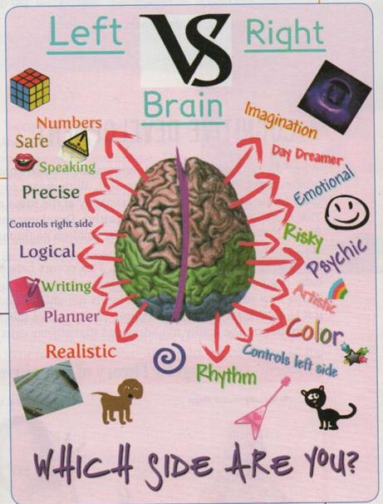

Slide 11
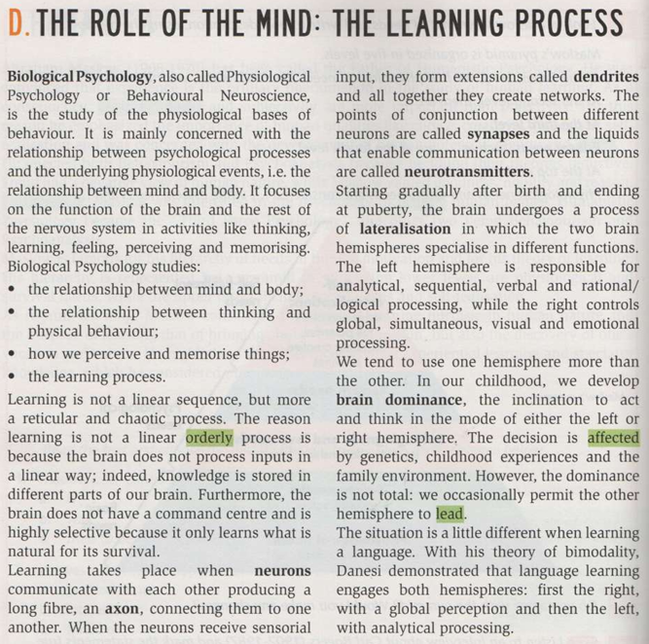

Slide 12
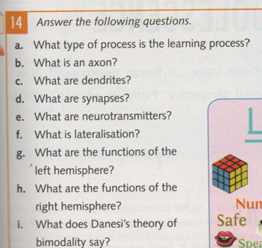
A
B
C
D
E
F
G
H
I

Slide 13

How do humans develop?

Slide 14
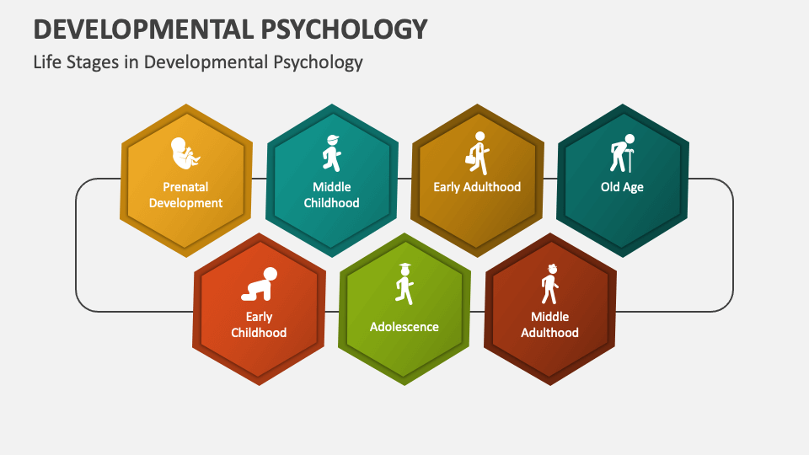
“Stages” is the keyword…

Slide 15
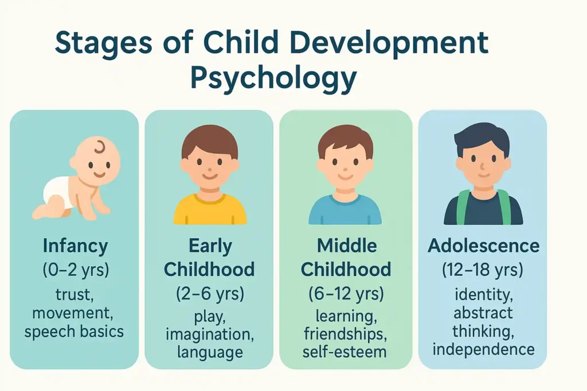
Children develop fast and in complex ways

Slide 16
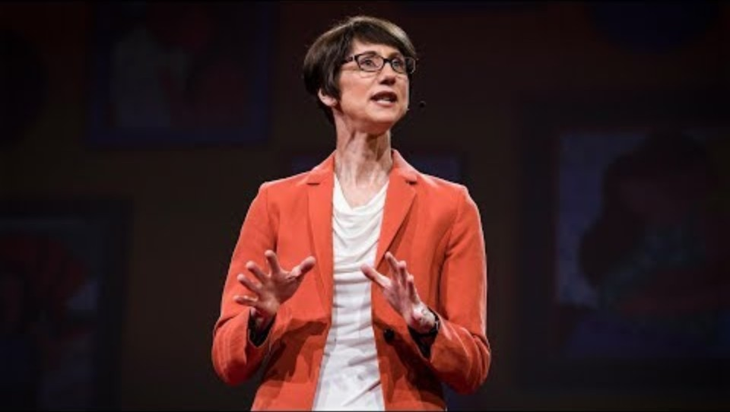
Lessons from the strongest study on human development – Helen Pearson
WHAT CHANGED HER MIND ON RAISING CHILDREN?
WHAT IS THE SCIENTIFIC STUDY SHE MENTIONS ABOUT? WHO DOES IT FOCUS ON?
WHAT IS THE MOST IMPORTANT DISCOVERY OF THIS STUDY, ACCORDING TO THE SPEAKER?
WRITE DOWN SOME OF THE FACTORS THAT INFLUENCE CHILDREN’S FUTURE ACCORDING TO THE STUDY.
WHAT’S THE RELATIONSHIP BETWEEN POVERTY AND PARENTING?

Slide 17

Assignment
  Work in groups of 3 to 4;
  Look on the Internet or in books for scholars and developmental psychologists (do not settle for the most famous);
  Take note of some of their ideas and research interests;
  Be ready to share your findings with the rest of the class.

Slide 18
THANK YOU
See you next time!

