Slide 1





IUSTO
ENGLISH CLASS
Cabassi Matteo

Slide 2





Previously, on the English class...

Slide 3
A SHORT AND BRIEF REVISION

Slide 4

  Article: The influence of AI on Education
  Howard Gardner’s theory of multiple intelligences;
  vocabulary worksheet: words and phrases on multiple intelligences;
  Groups and assigned intelligence;
  assignment: prepare your presentations.
Main points from our last lesson

Slide 5
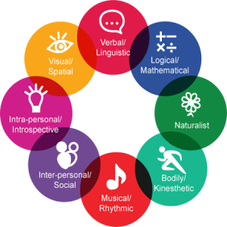
Multiple Intelligences

Slide 6



Multiple Intelligences and learning styles
Today’s class: objectives and topics

Slide 7
Objectives:
  To learn about specific topics for educators and teachers;
  To enlarge and enrich vocabulary on a specific area of technical English;
  To improve reading, listening and comprehension skills;
  To learn English in a practical situation and to exercise one’s own ability to teach through language;
  To work on writing coherent and understandable texts on technical and scientific topics;
  To improve speaking skills by working in groups and acting in role plays;
  To boost confidence and learn to talk in front of a crowd.
Today’s class: objectives and topics

Slide 8

OUR FIRST PRESENTATION!
The presentation counts towards the final grade for up to 3 points (0-3).
The assigned points are individual.
Each group has 6-8 minutes to present their work and a couple of minutes (2) to do the exercise with the other students.
ALL MEMBERS of the group are supposed to speak.

Slide 9
LET’S PRESENT YOUR WORKS!
Present your work(s) in front of the class

Slide 10
LEARNING STYLES

Slide 11
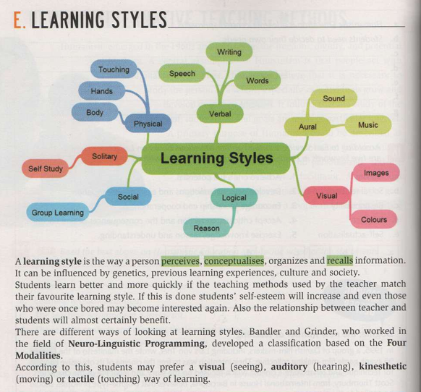
WHAT’S A LEARNING STYLE?
HOW MANY LEARNING STYLES EXIST ACCORDING TO BANDLER AND GRINDER?
HOW DO LEARNING STYLES INFLUENCE LEARNING?

Slide 12
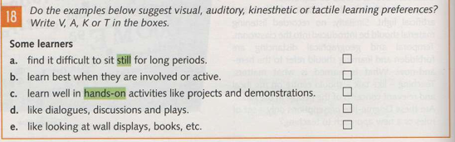
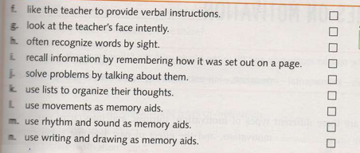
A.
B.
C.
D.
E.
F.
G.
H.
I.
J.
K.
L.
M.
N.

Slide 13

Assignment
  Open the “English Materials and Topics”;
  Go to page 14 and read “The Role of the Mind: The Learning Process”;
  Do the writing assignment and be ready to discuss it and read it in class.

Slide 14
Writing activity. Reflection
Write a reflective paragraph on Personal Learning Styles and their development (250-300 words)
Individually, students write a paragraph about which learning style they believe is most dominant in themselves, how they could use it in their future job as educators, as well as possible ideas on how to guide children and kids in developing their own.

Slide 15

THANK YOU
See you next time!

