Slide 1





IUSTO
ENGLISH CLASS
Cabassi Matteo

Slide 2





Previously, on the English class...

Slide 3

Main points from our last lesson
  information on the course and on the exam;
  entry test (+ check);
  Motivation: TED Talk “Every kid needs a champion”.

Slide 4

The impact of AI on education: article

Slide 5
2. Teaching metaphors
Individually: complete the following metaphor.
“Being an educator is like ... because ...”
Example: Being an educator is like gardening because it takes patience and care.
Share the metaphors in groups of 3-4.
Decide on the best one together.
Explain your group metaphor to the class.

Slide 6

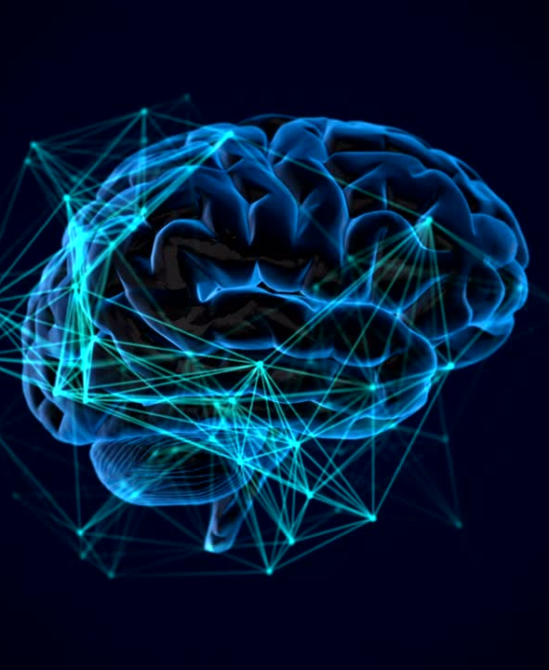


Multiple Intelligences
Today’s class: objectives and topics

Slide 7
Objectives:
  To learn about specific topics for educators and teachers;
  To enlarge and enrich vocabulary on a specific area of technical English;
  To improve reading and comprehension skills;
  To exercise listening skills and understanding complex videos in English;
  To work on writing coherent and understandable texts.
Today’s class: objectives and topics

Slide 8

Warm-Up Discussion (10 minutes)
Topic: "What makes a person smart?"
Activity: In groups of four (4), students discuss their own definitions of intelligence. They also need to identify possible types of intelligence and share some examples.
Warm up

Slide 9
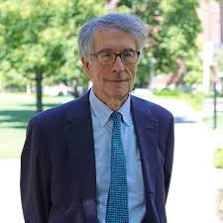
Introducing Multiple Intelligences
Howard Gardner is an American developmental psychologist, born in 1943, best known for his theory of multiple intelligences. A professor at the Harvard Graduate School of Education, Gardner challenged the traditional view of intelligence as a single ability by proposing a model of multiple intelligences in his 1983 book, Frames of Mind. His model includes eight distinct types of intelligence, such as linguistic, logical-mathematical, and musical. Gardner's work has greatly influenced education, encouraging personalized teaching methods that cater to individual strengths.

Slide 10
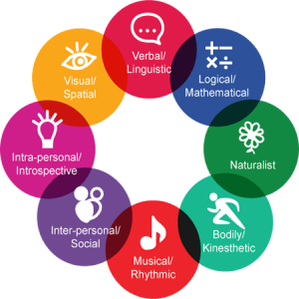
Introducing Multiple Intelligences
Howard Gardner’s 1983 theory of multiple intelligences challenges the idea of intelligence as a single capability. Instead, Gardner identifies eight distinct types of intelligence, including musical, visual-spatial, verbal-linguistic, logical-mathematical, bodily-kinesthetic, interpersonal, intrapersonal, and naturalistic. Each type represents a unique way individuals learn, process, and apply knowledge. Gardner’s work has influenced education by encouraging diverse teaching methods to cater to each student’s strengths. His theory suggests that intelligence is multifaceted, emphasizing the importance of varied skills beyond traditional IQ measurements.

Slide 11

Let’s work on vocabulary and words.

Slide 12

Writing activity. Reflection
Write a reflective paragraph on Personal Learning Styles.
In groups of three or four, students write a paragraph about which intelligence they believe is most dominant in themselves, how did they discover it, if high school/university helped them develop it and their personal way of learning.

Slide 13
1. Sentence Starters:
  Identifying the Intelligence:
    “I believe my strongest intelligence is ___ because I enjoy/ am skilled at…”
    “I feel I relate most to ___ intelligence, as I often find myself…”
  Explaining How It Manifests:
    “This intelligence shows up in my daily life through activities like…”
    “In my learning, this helps me to…”
  Relating to Teaching:
    “As a teacher, I could use this intelligence by incorporating…”
    “This intelligence would allow me to… when teaching.”
Useful language and prompts.

Slide 14
Useful language and prompts.
2. Linking Phrases:
  Cause and Effect: “Due to my strength in…,” “As a result, I find it easier to…”
  Adding Examples: “For instance,” “Such as,” “This includes activities like…”
  Transitions: “Moreover,” “In addition,” “Another way this intelligence benefits me is…”

Slide 15
PRESENTATIONS: First round
  Divide into 8 groups.
  Each group gets 1 type of intelligence.
  Each group creates a short presentation (max 6-8 minutes). The presentation must contain: 1 slide on the general characteristics of the assigned intelligence; 1 slide with an activity designed to develop said intelligence; 1 final slide with a short exercise designed for the students who are listening to the presentation (a classroom scenario to solve by using the assigned intelligence).
  Each group presents their results.

Slide 16
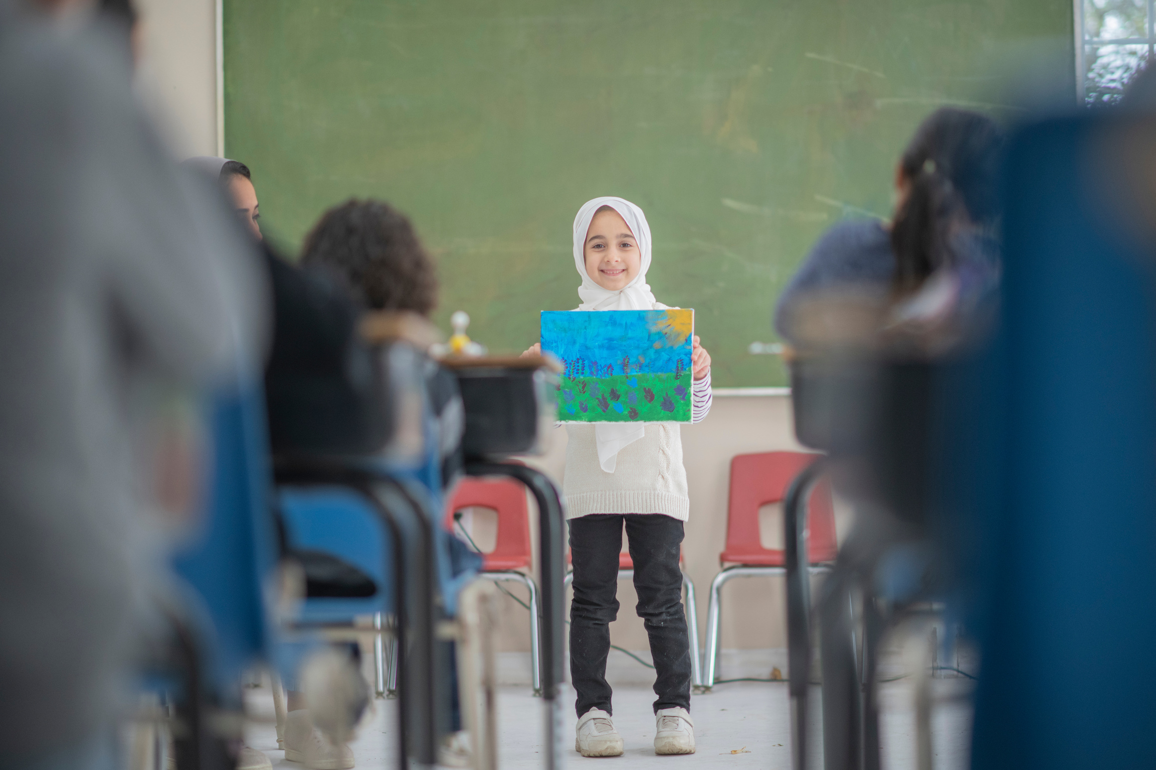
Assignment
  Open the ENGLISH MATERIALS AND TOPICS section (Materiali)
  Go to page 7 of the PDF
  Read “Learning Styles”
  Do exercises 17-18.
  Work on your presentations and be ready to discuss them in front of the class!

Slide 17
THANK YOU
See you next time!

