Slide 1





IUSTO
ENGLISH CLASS
Cabassi Matteo

Slide 2





Welcome, Students!

Slide 3

Main requirements: class preparation and participation.
Materials: download from the University website (Professor page).
Activities: mainly speaking and conversation.
Four skills: reading, writing, speaking and listening.
Assignments: to do at home and discuss in class.
Information on the course and syllabus

Slide 4
Syllabus.
A range of topics and ideas from the world of education, educators, teaching, developmental psychology, life stages.
A range of materials: videos, texts, debates, movies, literature.
THE COURSE IS OPEN TO STUDENTS’ SUGGESTIONS.
Information on the course and syllabus

Slide 5
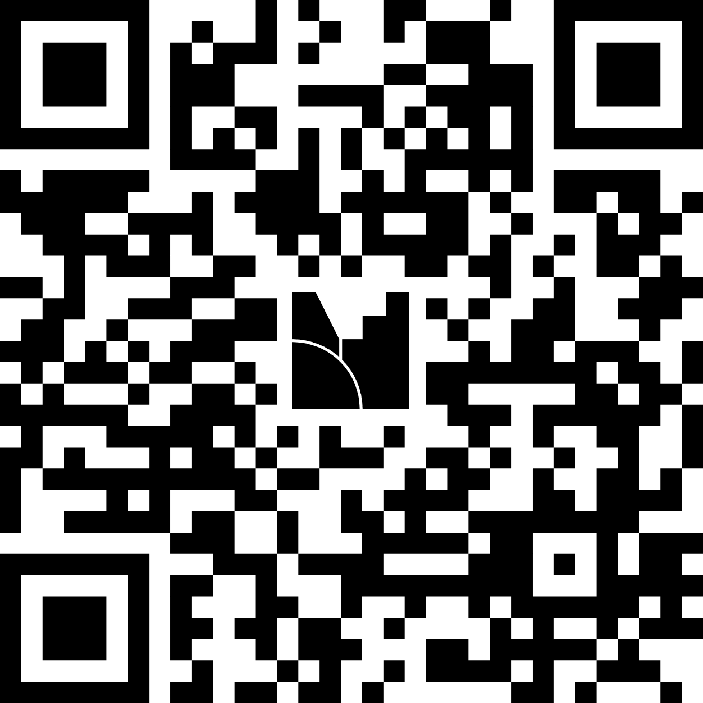
What would you like to learn from this course?

Slide 6

My English learning experience was…

Slide 7
Class Objectives and Rules
Objectives: each lesson will have its own personalized objectives.
Overall: increase vocabulary, gain specialized knowledge in thie field of education, improve the four skills.
Level: B1 (target).
Students’ interests and ideas.
Participation is not only encouraged, but mandatory. The main aim of this class is to improve your speaking skills.
Based on technical language.
Use of presentations, group discussions, debates.

Slide 8
Oral exam.
Be prepared on the topics discussed in class.
Prepare a short presentation on a chosen topic.
The topic might not be from the syllabus (let’s discuss it together, first).
Class presentations (two).
Final end-of-term exam (esonero) – written (non-mandatory).
The exam(s)

Slide 9
Oral exam.
Be prepared on the topics discussed in class.
Prepare a short presentation on a chosen topic.
The topic might not be from the syllabus (let’s discuss it together, first).
Class presentations (two).
Final end-of-term exam (esonero) – written (non-mandatory).
The exam(s)

Slide 10


First: a short test
Our first step is going to be a short, written test to see what everybody’s level is.
We are going to check the test together and discuss the results.
THE TEST WILL TAKE 60 MINUTES.

Slide 11
Let’s check the test!
Let’s check the test together. We are going to work on it together: keep track of your scores. We are going to discuss them at the end of this section.

Slide 12
Speaking session
Get-to-know-you activities and speaking practice.

Slide 13

  Two truths and a lie. Pedagogical twist.
  Groups of 3-4 students.
  Each student shares two truths and one lie about themselves (related to their educational journey, teaching experiences, or language learning).
  Group members guess which statement is the lie, sparking discussion and allowing them to learn about each other.
  Relate funny stories to the class.

Slide 14
2. Teaching metaphors
Individually: complete the following metaphor.
“Being an educator is like ... because ...”
Example: Being an educator is like gardening because it takes patience and care.
Share the metaphors in groups of 3-4.
Decide on the best one together.
Explain your group metaphor to the class.

Slide 15
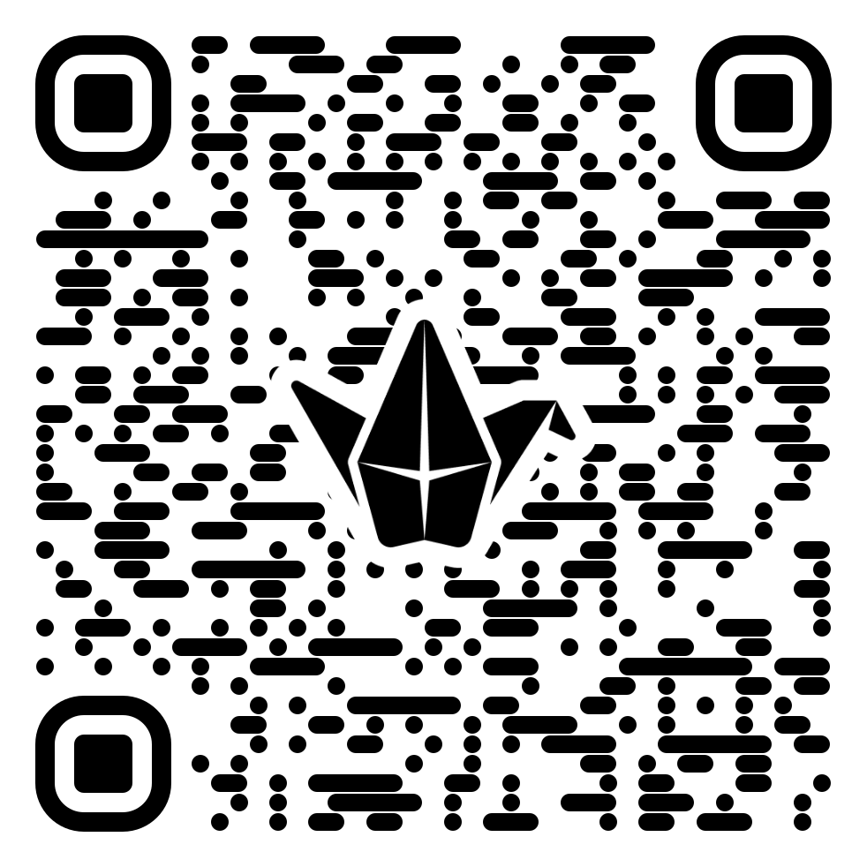
Rita Pierson, a teacher for 40 years, once heard a colleague say, "They don't pay me to like the kids." Her response: "Kids don't learn from people they don't like.'" A rousing call to educators to believe in their students and actually connect with them on a real, human, personal level.
TED Talk.
“Every kid needs a champion”
Rita Pierson
What makes a good educator?
Discuss the results in groups before watching the video.

Slide 16
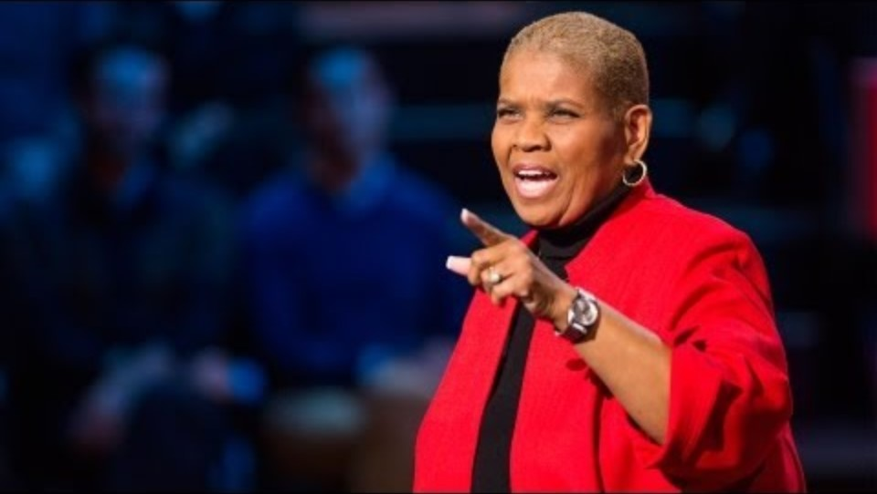
TED Talk.
“Every kid needs a champion”
Rita Pierson
  What is the most important element in teaching and learning?
  What is Stephen Covey’s idea?
  What is one of the things she found hard to overcome?
  Can you summarize the saying she gave to the students?
  Why do tough students keep showing up?
  What is the meaning of “every kid needs a champion”?

Slide 17

Additional Resources
How AI is changing Education

Slide 18

Assignment
  Read the text
  Be prepared to discuss the text in class and answer the questions
  Prepare a brief mind-map or spider-gram.

Slide 19
THANK YOU
See you next time!

